Slide 1
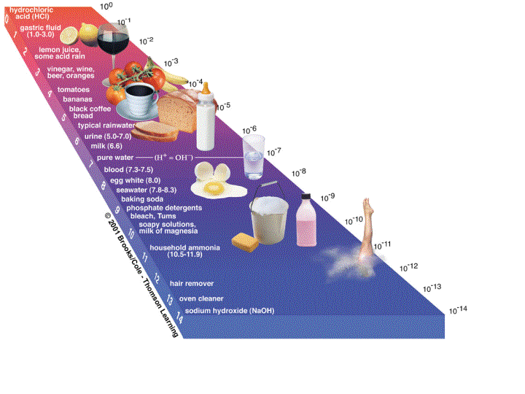
Acids and Bases

Slide 2
Acids & Bases
Acids
Bases
Sour Taste
Reacts with certain metals
on table J to yield H₂(g)
Great Electrolytes (Why?)
Excellent Conductors of Electricity (Why?)
Cause Acid/Base Indicators to change colors
Bitter
Slimy
Great Electrolytes (Why?)
Excellent conductors of Electricity (Why?)
Cause Acid/Base Indicators to change colors
Acid reacts with Base to yield Salt and Water
Called the “Neutralization Reaction”

Slide 3
The Neutralization Reaction
Acid + Base -------------> Salt + Water
HCl + NaOH --------> NaCl + H2O
What kind of Reaction do you See?
Double Replacement

Slide 4
The Hydrolysis of a Salt The Reverse Reaction
Adding water to a salt!
Water + Salt --------> Acid + Base
H2O + NaCl -------------> HCl + NaOH
Called “The Parent Acid and Base”

Slide 5
Definitions of Acid and Base Arrhenius
Acid
Base
Any substance that yields (H⁺) as
the only positive ion in solution
HCl ------------> H⁺ + Cl⁻
HBr ------------> H⁺ + Br⁻
H₃O+ ----------> H⁺ + HOH
H₃PO₄ ---------> H⁺ + H₂PO₄⁻
H₂PO₄ - -------> H⁺ + HPO₄⁻²
HPO₄⁻² --------> H⁺ + PO₄ ⁻³
Any Substance that yields (OH-) ion
as the only (-) ion in solution
(Recall: Goup I,II Metal with OH
and NH₄OH)
NaOH --------> Na⁺ + OH⁻
Ca(OH)2 -----> Ca⁺² + 2OH⁻
NH₄OH ----> NH₄⁺ + OH⁻
Reminder: Do not confuse Base with Alcohols!
(Hydrocarbon-OH)
CH₃OH
CH₃CH₂OH

Slide 6
Amphoterism Any Substance That can act as either acid or base
H₃O+ ----------> H⁺ + HOH HOH ------------> H⁺ + OH⁻
H₃PO₄ ---------> H⁺ + H₂PO₄⁻ H₂PO₄ - -------> H⁺ + HPO₄⁻²
HPO₄⁻² --------> H⁺ + PO₄ ⁻³

Slide 7
Definitions of Acid and Base Bronsted - Lowery
Acid
Base
Proton (H⁺) Donor
Proton (H⁺) Acceptor
H⁺ H⁺
H₂O + H₂O -------------> OH⁻ + H₃O⁺
Strong Acid (SA) ----------> H⁺ + Weak Base (WB)
Weak Acid (WA) ------------> H⁺ + Strong Base (SB)

Slide 8
Strong Acids and Strong Bases
Strong Acids
HCl
HBr
HI
H₂SO₄
HNO₃
StrongBases
Group I M
Ca, Sr, Ba with OH

Slide 9
pH Scale
pH Scale
Is a scale that is used to measure if a substance is an acid or base
Measures the Percent [H+] (The power of Hydrogen!)

Slide 10
pH Scale
****_____
For every decrease in pH value, this represents a 10x Increase in [H⁺]
5 <---------- 6 <------------ 7 <----------- 8
10 x 10 x 10 x
<-------------------------------------------------------------
1000 x

Slide 11
pH Calculations
K_{sp} (The ionization of H2O)
H₂O <-----------> H⁺aq + OH⁻ aq
K_{eq} = [H+] [OH-] Fact K_{H2O} = 1 x 10 ⁻¹⁴
1 x 10⁻¹⁴ = [H+] [OH-]
[H⁺] = 1 x 10⁻⁷ [OH⁻] = 1x 10⁻⁷
Calculate pH
pH = -log[H⁺] pOH = -log[OH⁻]
pH = 7 pOH = 7
pH + pOH = 14

Slide 12
The Hydrolysis of a Salt!
Remember (it is the reverse reaction of a __________________ reaction)
KCl + HOH -----> KOH + HCl
How can we determine the pH of the resulting solution?
Neutralization

Slide 13
Determine the pH of the Resulting Solution
Strong Acids
HCl
HBr
HI
H₂SO₄
HNO₃
StrongBases
Group I M
Ca, Sr, Ba with OH
N
0
SA
SB
14

Slide 14
Determine the pH of the Resulting Solution
Na₃PO₄ + H(OH) <----------->
NaOH + H₃PO₄
Mg(Cl)₂ + H(OH) <---------->
KBr + H(OH) <---------->
N
0
SA
SB
14

Slide 15
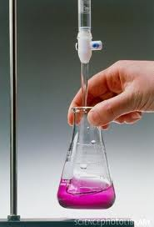
Titration
Def. A technique that is used to determine the strength of an unknown (acid or base) compared with a known (acid or base).
(coef A) M_{A}V_{A} = M_{B}V_{B} (coef B)
We need an acid base indicator:
Phenolphthalein Acid Base
clear Pink

Slide 16
Titration Technique
Steps.
Set up 2 burets using a stand and holder.
Add acid in one buret #1 (standard solution) and base in buret #2 to a point and record the point looking at the bottom of the meniscus. This is the start point for measuring volume.
Slowly add the base to a flask (less volume is better) and record the volume used. Warning……
Add a few drops of indicator (clear)

Slide 17
Titration Technique
Steps.
Place flask under biuret #2 (Base)
Slowly add base to flask (watch for a color change to pale pink) ***Do not go past the end point!
Record the volume used.****Warning……..
Insert numbers into the equation!
(coef A) M_{A}V_{A} = M_{B}V_{B} (coef B)

Slide 18
Titration

Slide 19
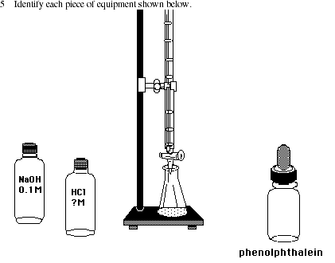
Titration
(coef A) M_{A}V_{A} = M_{B}V_{B} (coef B)

Slide 20
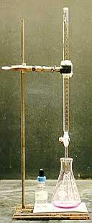
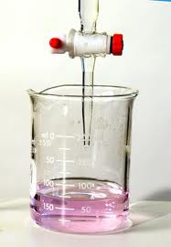
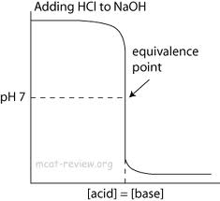
Titration and Calculations
(coef A) M_{A}V_{A} = M_{B}V_{B} (coef B)
End Point

Slide 21
Naming Acids
This is Review!
Binary (2 elements)
Tiernary (3 elements)
Always starts with “Hydro”
Name the Non-Metal (Chlorine)
Drop the ending, add ic acid
M(PI) M(PI)
ate – ic ite - ous
HCl Hydrochloric Acid
HBr Hydrobromic Acid
HI Hydroiodic Acid
H₂SO₄ Sulfuric Acid
HNO₃ Nitric Acid
HNO₂ Nitrous Acid
H₂SO₃ Sulfurous Acid

