Slide 1
Sexual Reproduction

Slide 2
Reproduction (def)
1. the production of individuals of their own kind
2. Necessary for the survival of the species, not
the organism
a. Species - a group of organisms that can
reproduce and produce fertile offspring
2 Types of reproduction
1. asexual
2. sexual

Slide 3
Asexual Reproduction |  | Sexual Reproduction
1 Parent | Parents | 2 Parents
Identical in looks and heredity (clones) | Offspring | Varied offspring Benefits?
Mitosis | Process | Meiosis
All cells of the body except the sex cells | Where does it take place? | Sex cells only
 |  | Gonads (Ovaries and Testes)
One Division |  | Gametes (Eggs and Sperm)
uncontrolled cell division = cancer |  | 2 divisions

Slide 4
Mitosis
The orderly series of changes that results in the duplication of the complete set of chromosomes and the formation of two new nuclei that are identical to each other and to the nucleus of the original parent cell
All cells arise from other cells by cell division
Nucleus duplicates and cytoplasm divides into two DAUGHTER CELLS
**ALL CELLS ARE GENETICALLY IDENTICAL
**CLONES

Slide 5
MITOSIS
46
Replication
92
Cytokinesis
46
46

Slide 6
Spermatogenesis
MEIOSIS
46
Primary Sex Cell
1st division
23
23
2nd division
23
23
23
23
4 Sperm Cells

Slide 7
Oogenesis
MEIOSIS
46
Primary Sex Cell
1st division
23
2nd division
23
Egg, Ovum, Oocyte
3 non-functional polar bodies

Slide 8
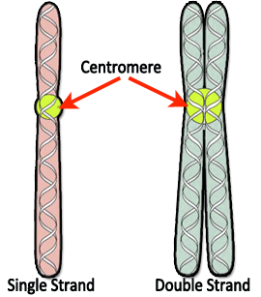
The Chromosomes and the numbers game!
What does it all mean?
Chromatids
Here We go! ***
2n = 46 Chromosomes
sooooo
n=23 get it?
2n (Diploid number)
n (monoploid number)
or Haploid # (half)

Slide 9
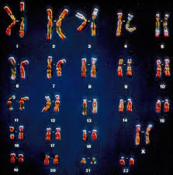
Soooo
We have a total number of chromosomes
(46) Diploid that exist in 23 homologous (similar) pairs
After the Chromosomes undergo meiosis, we then cut the chromosome number in HALF (Monoploid # or Haploid #)

Slide 10
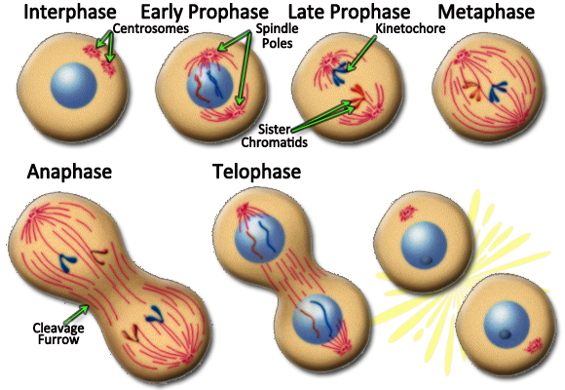

Slide 11
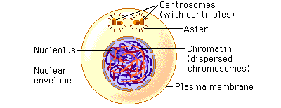
Interphase
Chromosomes replicate and the nuclear membrane disintegrates

Slide 12
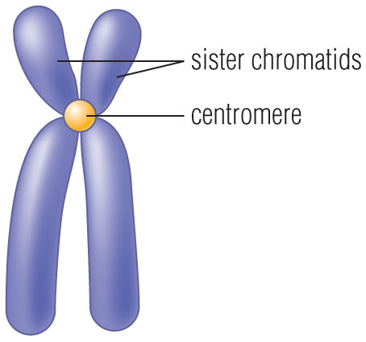
Prophase
Normally, genetic material is loosely bundled into CHROMATIN
At the beginning of prophase, these chromatin fibers become tightly coiled (Become Short, Thick, and Visible)
CHROMOSOMES
Chromosomes are made up of sister CHROMATIDS
which are bound together at a CENTROMERE
CENTRIOLES begin to move to poles

Slide 13
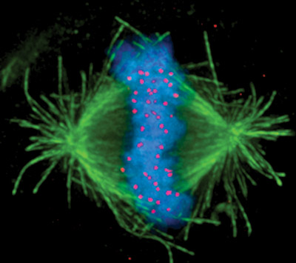
Metaphase
Chromosomes align along the equatorial line
SPINDLE FIBERS form and attach themselves to the chromosomes at the centromeres

Slide 14
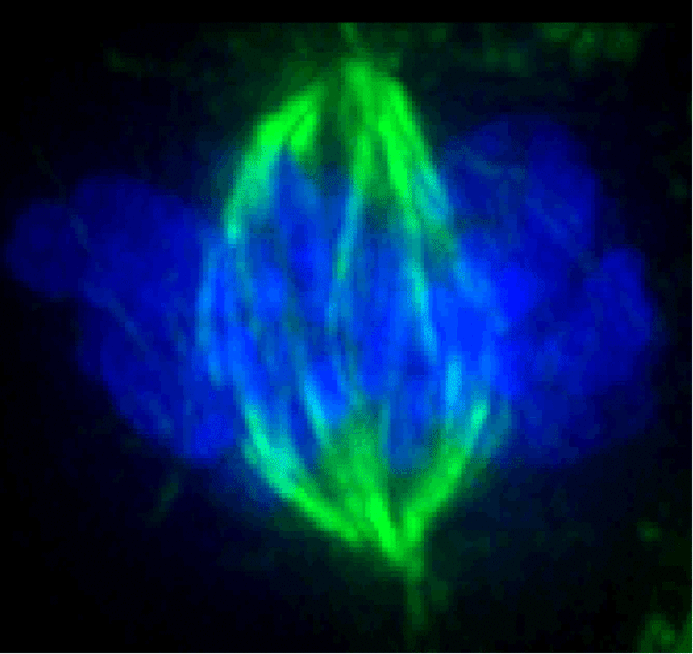
Anaphase
Sister chromatids begin to separate
Each Chromatid is pulled towards the opposite pole by the spindle fibers

Slide 15
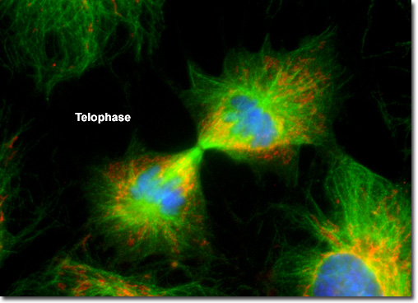
Telophase
New NUCLEAR MEMBRANE forms around the separated sister chromatids
Chromatids unwind back into chromatin
Cell membranes begin to pinch in to begin separating into two new cells (furroughing)

Slide 16
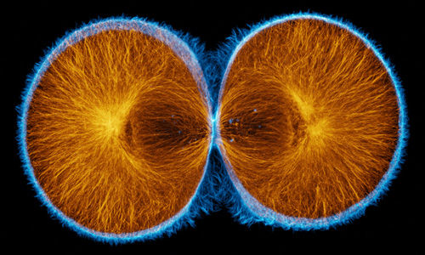
Cytokinesis
Cells completely split to form two daughter cells
Each cell is an exact copy of each other as well as the parent cell
In plant cells, cell pate forms which will then become a new cell wall

Slide 17
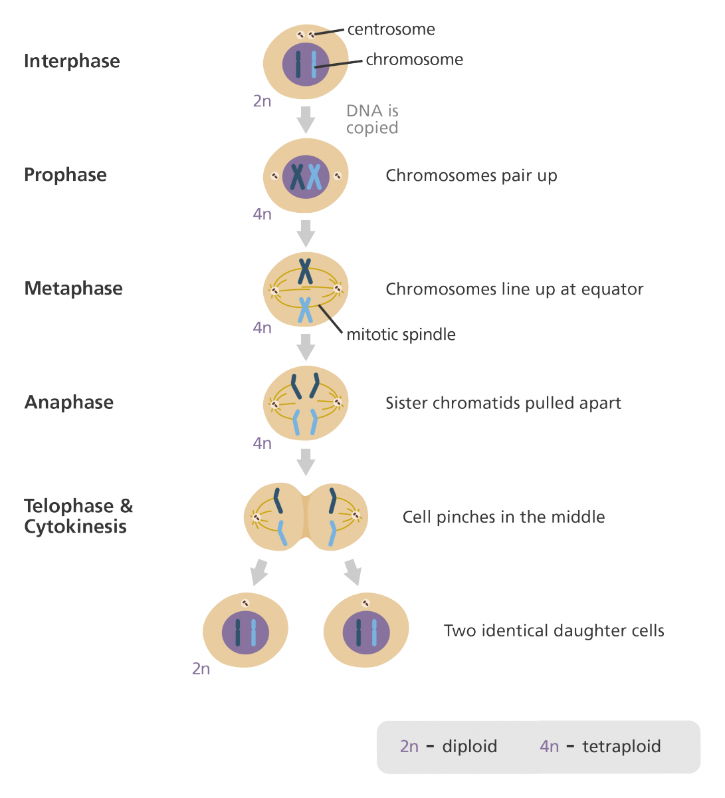

Slide 18
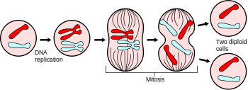

Slide 19
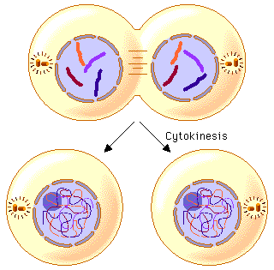
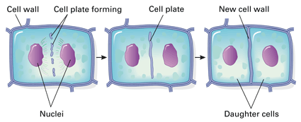
ANIMAL
PLANT

Slide 20
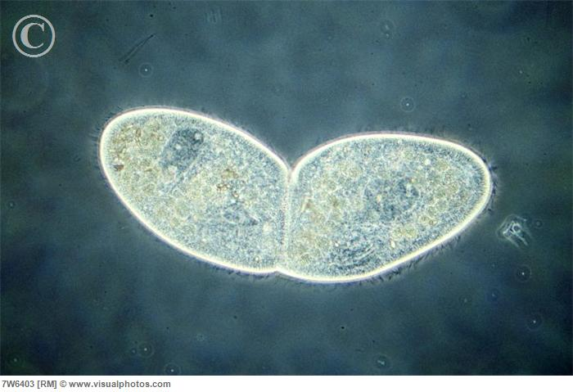
Binary Fission
Common in one-celled organisms
Nucleus divides by mitosis
Cytoplasm divides to form two daughter cells of equal size

Slide 21
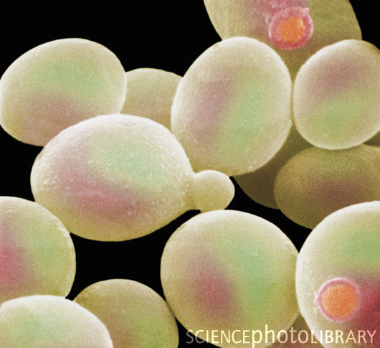
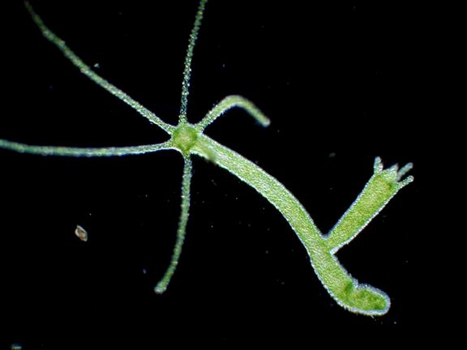
Budding
Very similar in nature to Binary Fission
Mitosis takes place to form small BUDS which contain identical genetic material
Unlike Binary Fission, there is an UNEQUAL distribution of cytoplasm
Some cells may separate while others may remain attached to the parent cell to form a colony

Slide 22
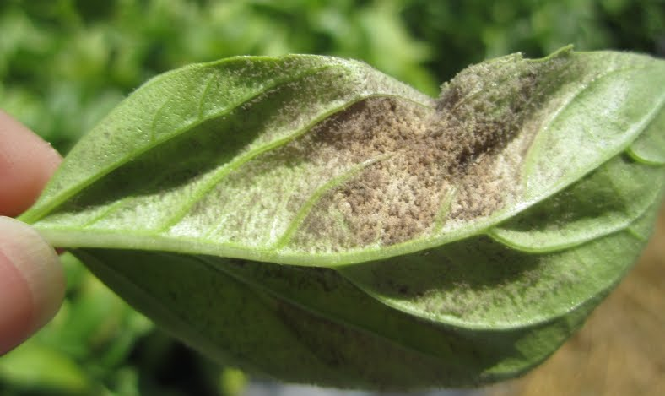
Sporulation
Often found in mold
Spores are produced through mitosis
Surrounded by a tough coat
Allows them to survive harsh environmental conditions

Slide 23
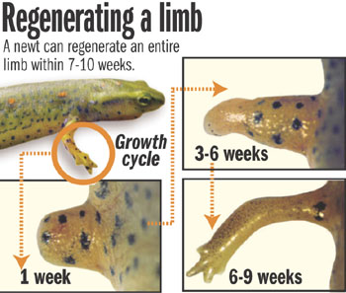
Regeneration
Replacement of Regrowth of a lost or damaged body part
Lobsters can regenerate a lost claw
Sea stars can develop from one arm and a part of the cntral disk of an existing sea star

Slide 24
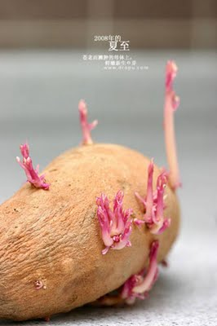
Vegetative Propagation
Occurs in plants
New plants can develop from the roots, stems, or leaves of a parent plant
Cuttings:
A piece of a previous plant can develop a new root system and survive on its own
Bulbs
Tubers
Potatoes
Runners

