Slide 1
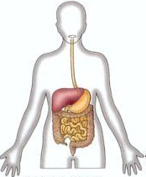
The HUMAN digestive system is essentially like that of the grasshopper and earthworm.
Food moves in one direction through a tube called the GASTROINTESTINAL (GI) TRACT.
Specialized organs carry out
mechanical digestion, chemical digestion, absorption of nutrients,
and elimination of waste.

Slide 2
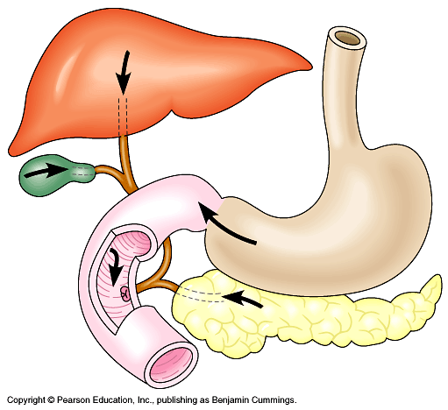
The human also has many specialized
ACCESSORY ORGANS,
including the
LIVER,
GALLBLADDER
and PANCREAS
that secrete enzymes and bile
into the digestive tract.

Slide 3
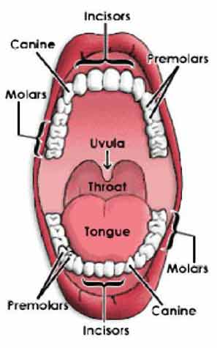
Food is ingested through the MOUTH,
and digestion begins there.
The TEETH function in the mechanical breakdown of food into smaller pieces.
Mechanical digestion provides a larger surface area for the action of digestive enzymes.

Slide 4
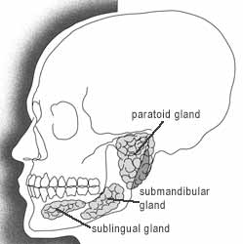
The SALIVARY GLANDS secrete saliva,
a fluid that contains an enzyme (amylase)
that begins the chemical digestion of starch.

Slide 5
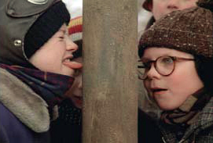
The TONGUE mixes saliva with the food by moving the food around in the mouth.
The tongue also moves the food mass to the back of the mouth for swallowing.

Slide 6
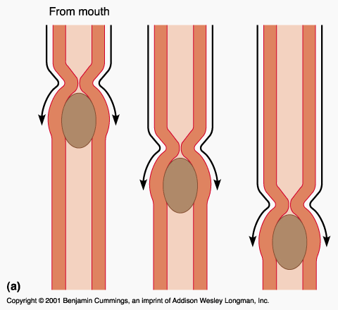
When food is swallowed, it passes into the ESOPHAGUS, and PERISTALSIS moves it downward to the stomach.
Digestion of starch continues while the food is in the esophagus.

Slide 7
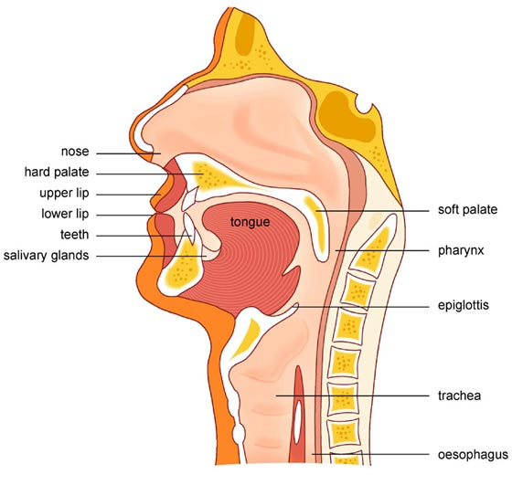
As it is swallowed, food passes the EPIGLOTTIS,
which prevents the food from entering the trachea.
peristalsis

Slide 8
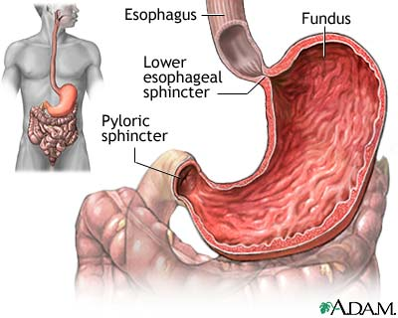
Food enters the STOMACH where it is mixed and liquefied.
GASTRIC GLANDS secrete
hydrochloric acid
and an enzyme
(gastric protease)
which begins the digestion of proteins.
Pepsinogen (inactive Protease)→ Pepsin (activated protease)
Hydrochloric acid provides the proper pH required
for effective functioning of gastric protease.

Slide 9
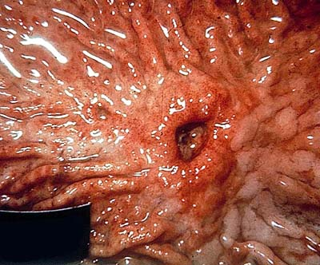
The stomach produces a MUCUS lining
to protect its surface from erosion by acid and enzymes.
Stress and bacterial infections can increase the risk of developing stomach ULCERS.
The same acids and enzymes cause HEARTBURN in the esophagus.

Slide 10
The liver, gallbladder, and pancreas secrete substances into the small intestine.
The LIVER produces BILE,
which passes into the GALLBLADDER, where it is stored temporarily.

Slide 11
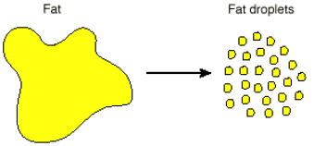
Normally, bile passes into the small intestine, where it breaks down fats into tiny droplets.
This process is known as EMULSIFICATION. It increases the surface area of fats.
Bile Also Neutralizes the PH to 7!

Slide 12
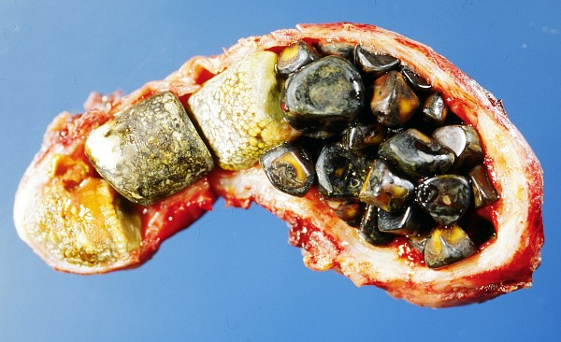
Some people have trouble with the crystallization of bile salts and cholesterol in their gall bladders that forms GALLSTONES.
These stones block the bile duct, preventing the digestion of fats, and can cause severe abdominal pain.

Slide 13
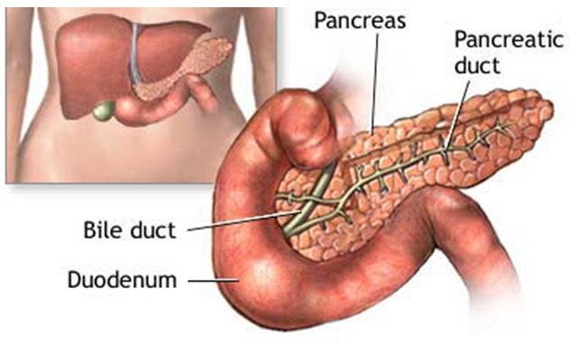
The PANCREAS produces enzymes that digest all types of food – carbs, lipids, and proteins.
These enzymes are used in the small intestine.

Slide 14
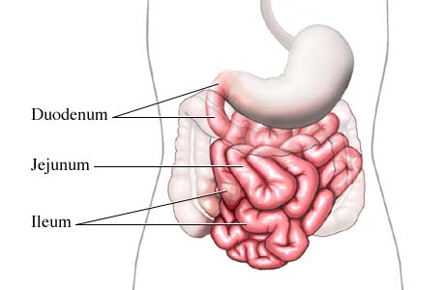
Partially digested food moves from the stomach into the SMALL INTESTINE.
The small intestine DIGESTS all kinds of food and ABSORBS nutrients into the bloodstream.

Slide 15
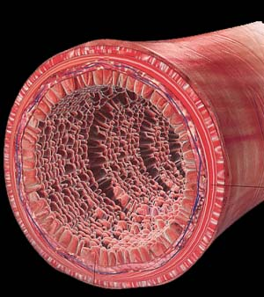
The walls of the SI are lined with INTESTINAL GLANDS
that secrete several different enzymes for
digesting proteins, lipids, and disaccharides.

Slide 16
ALL OF THE REMAINING NUTRIENTS ARE DIGESTED IN THE SMALL INTESTINE
with the help of secretions from the liver, the gall bladder,
the pancreas, and the
intestine wall.
Then the nutrients are absorbed into the bloodstream.

Slide 17
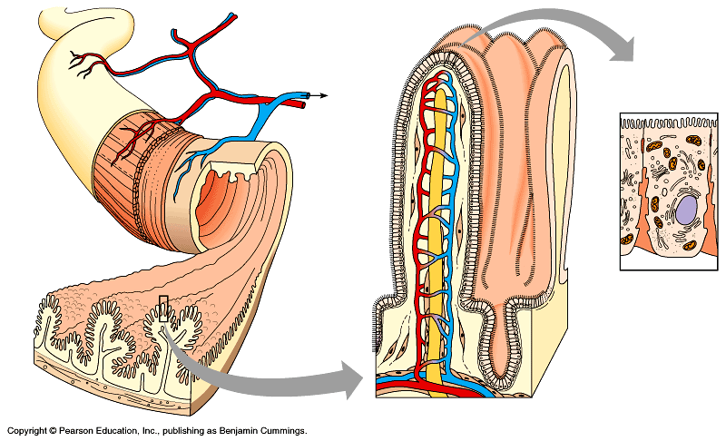
The intestine lining is covered in tiny projections called VILLI.
The villi provide a tremendous surface area where nutrients can be absorbed.

Slide 18
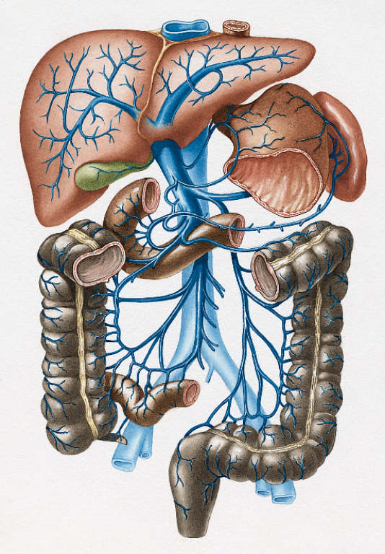
The nutrients circulate to the entire body, including to the LIVER, where excess glucose is converted into glycogen and stored for later use.
GLUCOSE
GLYCOGEN

Slide 19
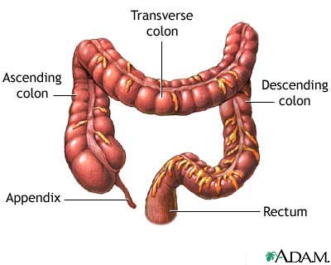
Finally, the material passes into the LARGE INTESTINE where water is absorbed and feces are formed.

Slide 20
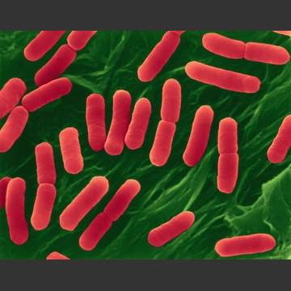
Intestinal bacteria digest the remains of your food and produce vitamins.
They also produce intestinal gas.

Slide 21
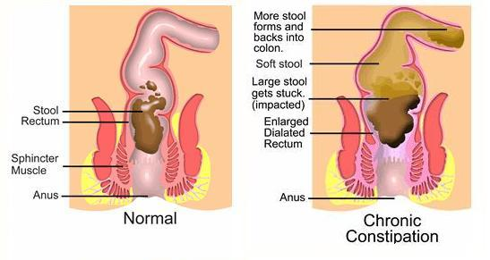
DIARRHEA and CONSTIPATION occur when the large intestine fails to function properly and homeostasis is disrupted.

Slide 22
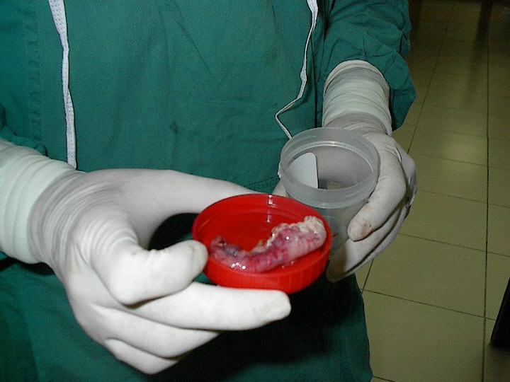
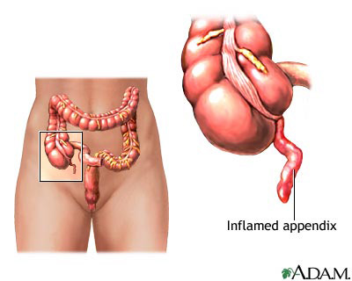
The APPENDIX is found where the small intestine meets the large intestine.
It has no important function in the digestive system and can be removed if it becomes infected.

Slide 23
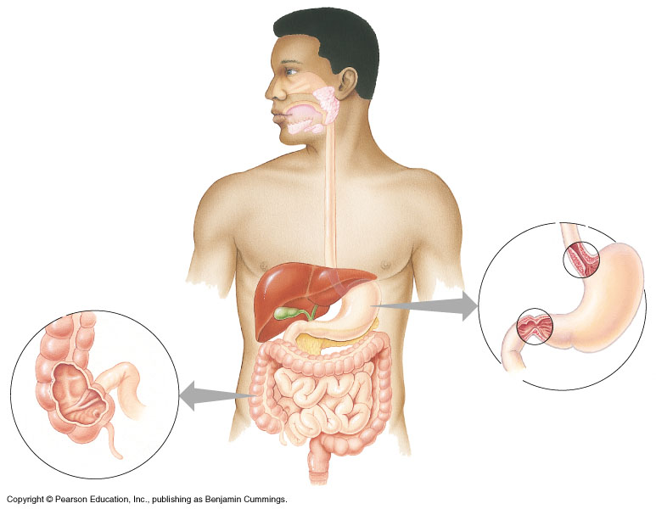

Slide 26
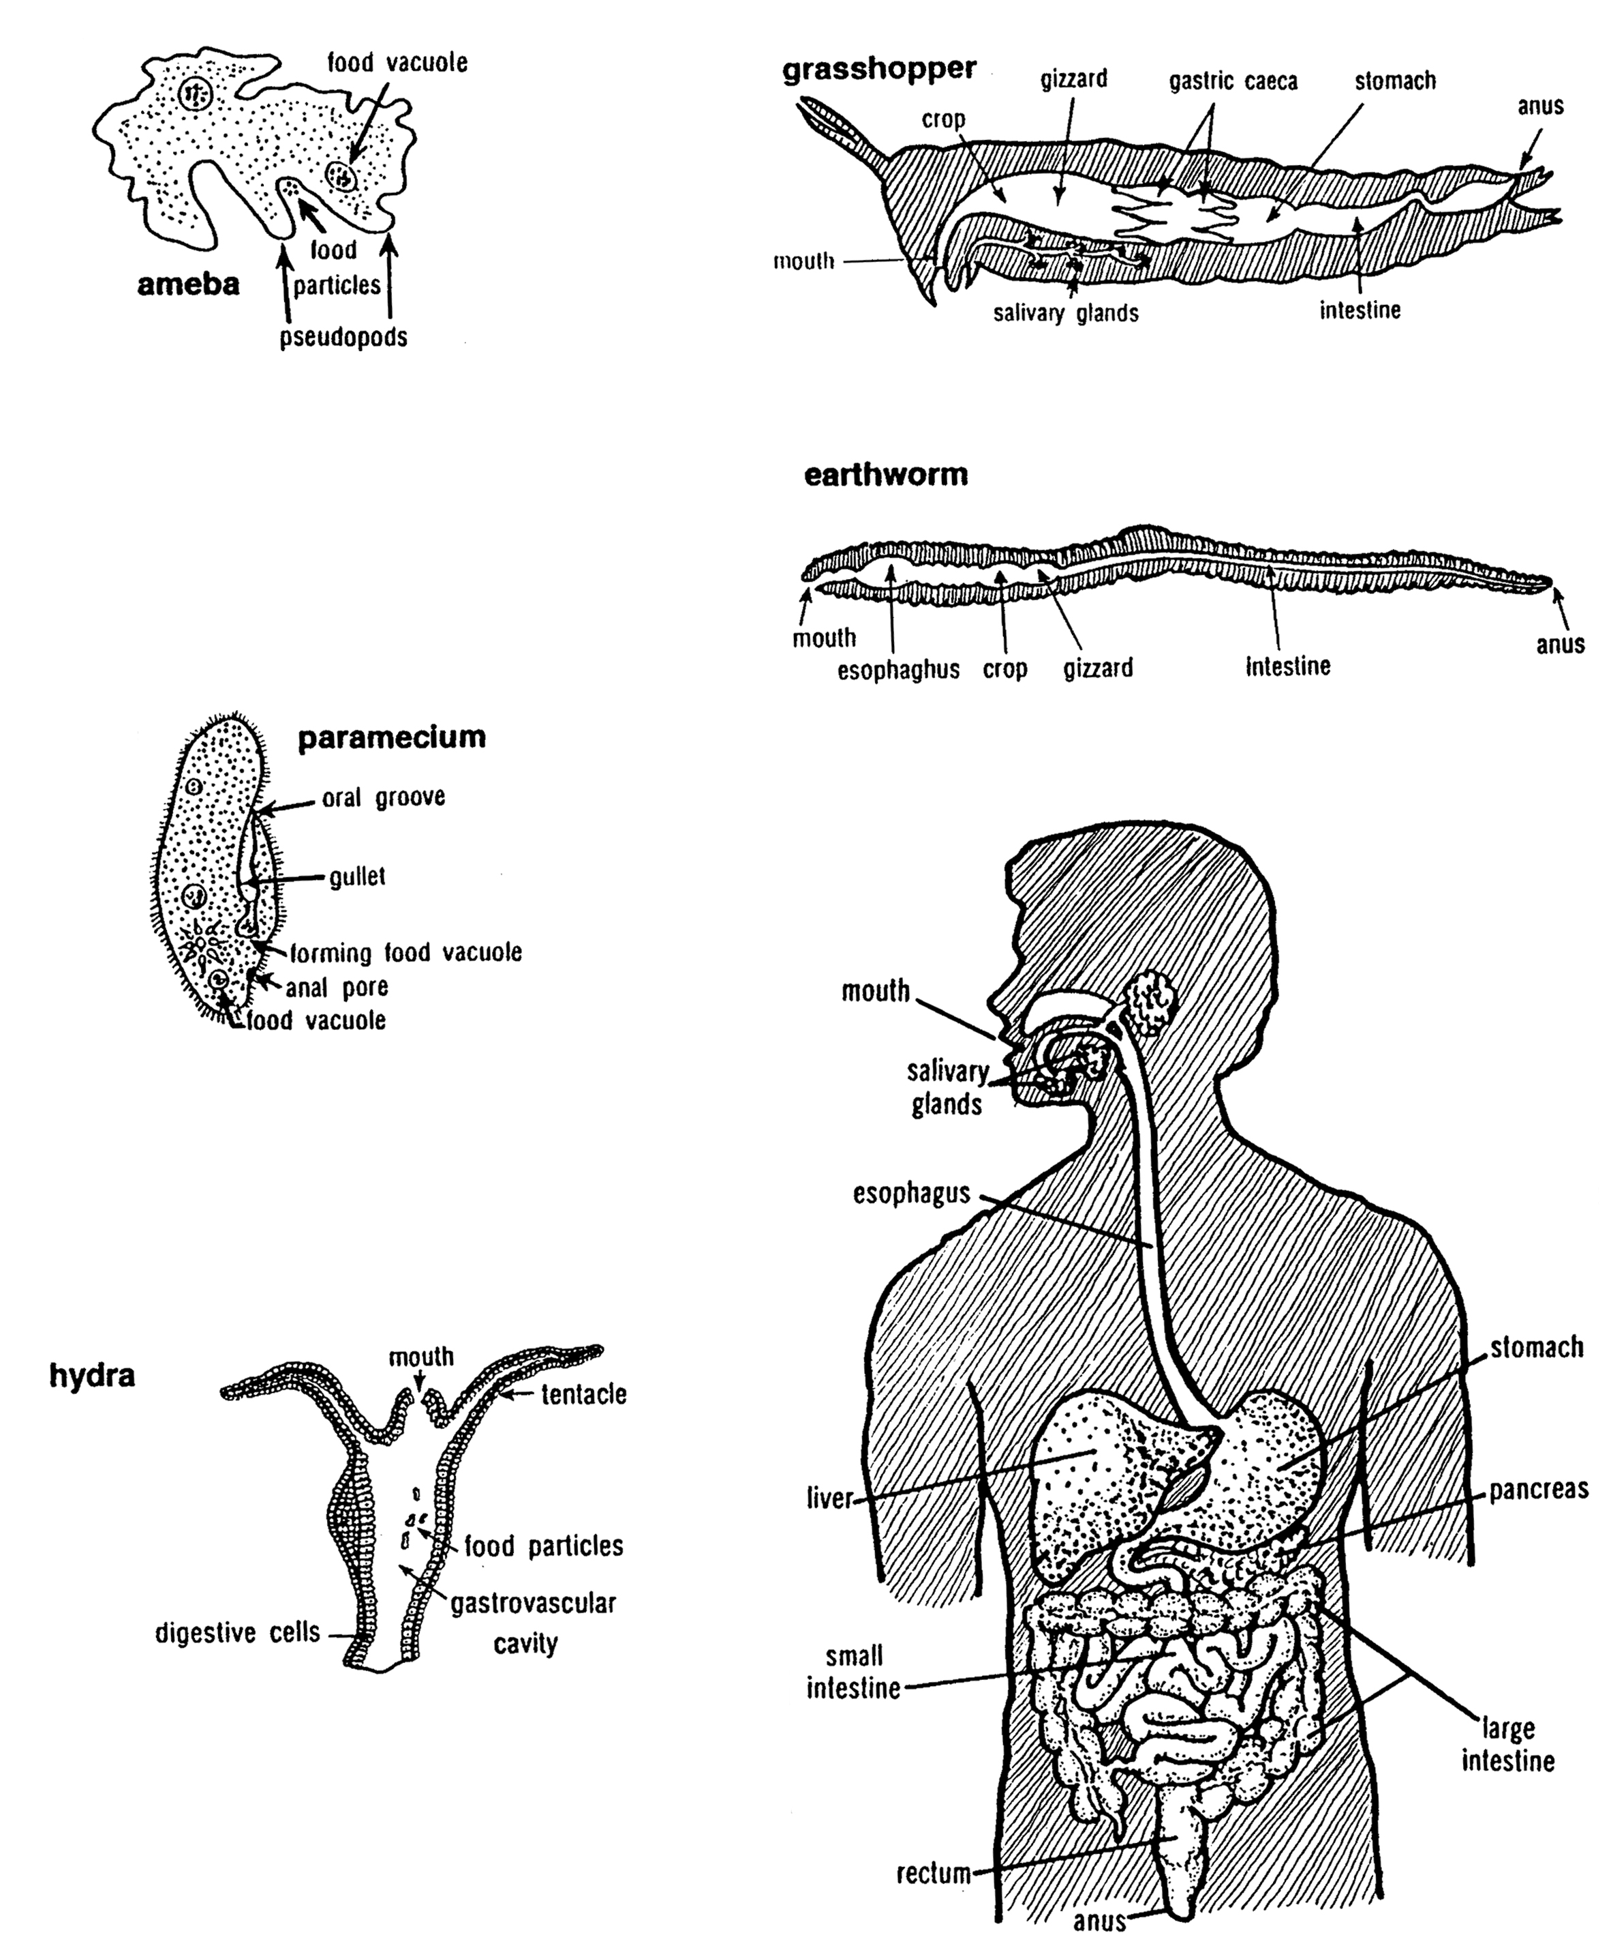

Slide 28
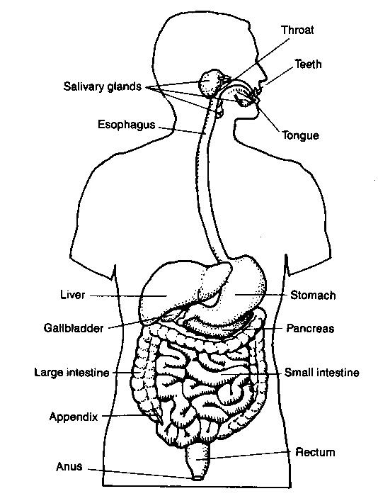

Slide 29
ORGAN | FOOD CHEMICALLY DIGESTED? YES/NO
 | CARBS | LIPIDS | PROTEINS
MOUTH
ESOPHAGUS
STOMACH
SMALL INTESTINE
LARGE INTESTINE
When ___________ are digested | ___________ are the end products
CARBS
LIPIDS
PROTEINS

Slide 30
ORGAN | FOOD CHEMICALLY DIGESTED? YES/NO
 | CARBS | LIPIDS | PROTEINS
MOUTH | Yes | No | No
ESOPHAGUS | (Yes) | No | No
STOMACH | No | No | Yes
SMALL INTESTINE | Yes | Yes | Yes
LARGE INTESTINE | No | No | No
When ___________ are digested | ___________ are the end products
CARBS | Simple sugars (glucose)
LIPIDS | Fatty acids and glycerol
PROTEINS | Amino acids

Slide 31
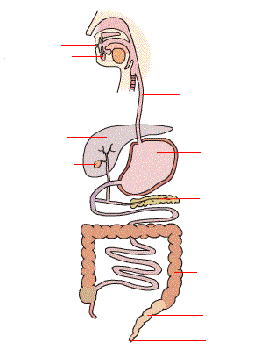
1
2
6
3
7
4
8
9
10
5
11
12

Slide 32
EPIGLOTTIS
MOUTH
SALIVARY GLANDS
ESOPHAGUS
LIVER
STOMACH
GALL BLADDER
PANCREAS
SMALL INTESTINE
LARGE INTESTINE
APPENDIX
RECTUM
ANUS

