Slide 1
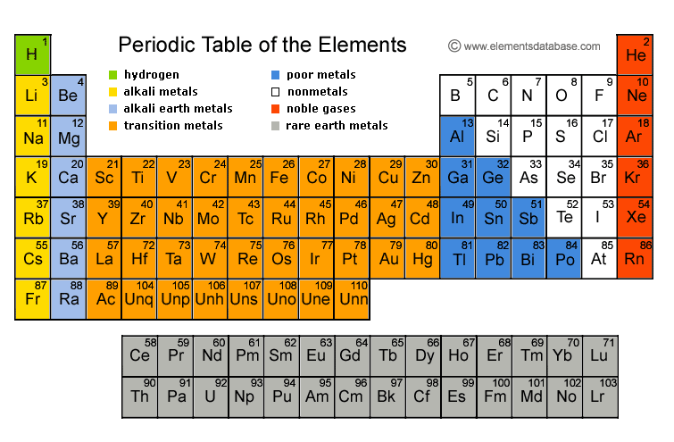
Periodic table

Slide 2
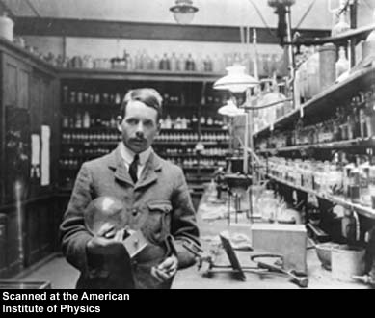
History and facts
First developed by Mendeleev
Later developed by Henry Mosley
Arranged the periodic table based on Atomic Number

Slide 3
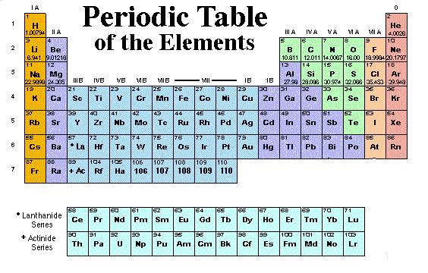
The periodic table
2/3 Metals 1/3 non metalls 2 liquids Hg & Br

Slide 4
Non- Metals
Soft , brittle
Insoluble in water
Poor conductors of heat and electricity
When they form bonds, they tend to:
Gain electrons
Form (-) ions – Anion
Ions are LARGER in size
Metals
Hard, soft
Excellent conductors of heat and electricity
Malleable- sheets
Ductile – wire
Luster – shine
High BP, MP.
When they form bonds, they tend to:
Lose electrons
Form (+) ions – Cation
Ions are Smaller in size
Metalloids
Characteristics of both Metals and non metals
Everything on the stair steps except:
DOG FOOD Al Po

Slide 5
Periods
Groups
Run up and down
Group numbers = # of val e⁻
(true for grps 1,2,13-18)
**You see the greatest
similarities within a group (due to the same of Val e-
Also see the fastest change from NM-M (grps 13-16)
Run from left to right across the p.t.
Periods = energy levels
You see the greatest differences among the elements as you move across the periods

Slide 6
groups
Alkali Metals
Most reactive metals
+1 oxidation number
Form oxides with the general formula of M₂O
Alkaline Earth Metal
Reactive, not like Group 1
+2 oxidation number
Form oxides with the general formula MO
3 – 12. Transitional Elements
Fill multiple energy levels at a time
*** Always yield pretty colors
13 -16. Metalloids
Characteristics of metals and non- metals

Slide 7
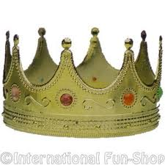
groups
17. Halogens
Most reactive non metals (F)
Oxidations numbers (-1), if with Flourine (+)
18. Noble Gases (Inert Gas)
Most stable
Full octet of 8 valence electrons

Slide 8
Trends of the periodic table *** remember this !!! ( m e r I )
M = Metallic Character
E = Electronegativity
R = Atomic Radii
I = Ionization Energy

Slide 9
Trends of the periodic table *** remember this !!! ( m e r I )

Slide 10
Metallic Character
Where are the most Metallic elements found?
F
Cs
Fr

Slide 11
electronegativity
Where are the most Non-Metallic elements found?
Def. The love or affinity for electrons (attraction of electrons to a nucleus)
Based on a scale (Fr) 0.9 – 4.0 (F)
F
Cs
Fr

Slide 12
Atomic radii
NOTE: All trends are taught explaining the increased trend, A.R. is explained why it decreases
F
r
Cs
Fr
***As you move from LEFT to RIGHT across the periodic table, the Atomic Radius will DECREASE due to an INCREASED NUCLEAR CHARGE attracting electrons in closer.
****
What’s Nuclear Charge you ask? Recall Subatomic particles!
Atomic # = # of protons→ found in the Nucleus→ (+) nuclear charge!!!

Slide 13
ionic radii
***As you move DOWN the periodic table, the Atomic Radius will INCREASE due to an INCREASE in ENERGY LEVELS
(Sounds like Common Sense…..it is!)
 | Form Bonds Tend to | Form Ion | Called | Size
METALS | Lose e- | + | Cations | Smaller
NON- METALS | Gain e- | - | Anion | Larger
Na
F-
Na⁺
F

Slide 14
Atomic Radii overall
Smallest
Largest
Smallest
Largest

Slide 15
Ionization energy
The amount of energy required to remove the outer most (valence) electron, results in the formation of an ion.
Where are the highest I.E.’s Found?
Which is the smallest? Most Non-Metallic?
Na⁰ + Energy → Na⁺ + e⁻
ionization
energy
Non-Metals:
Do not like to lose electrons
Smallest/ Tighter
hold of electrons
F
Cs
Fr

