Slide 1
Bones of the Pelvic Girdle
Formed by two coxal (ossa coxae) bones
Composed of three pairs of fused bones
  Ilium
  Ischium
  Pubis
Pelvic girdle = 2 coxal bones, sacrum
Bony pelvis = 2 coxal bones, sacrum, coccyx

Slide 2
Bones of the Pelvic Girdle
The total weight of the upper body rests on the pelvis
It protects several organs
  Reproductive organs
  Urinary bladder
  Part of the large intestine

Slide 3
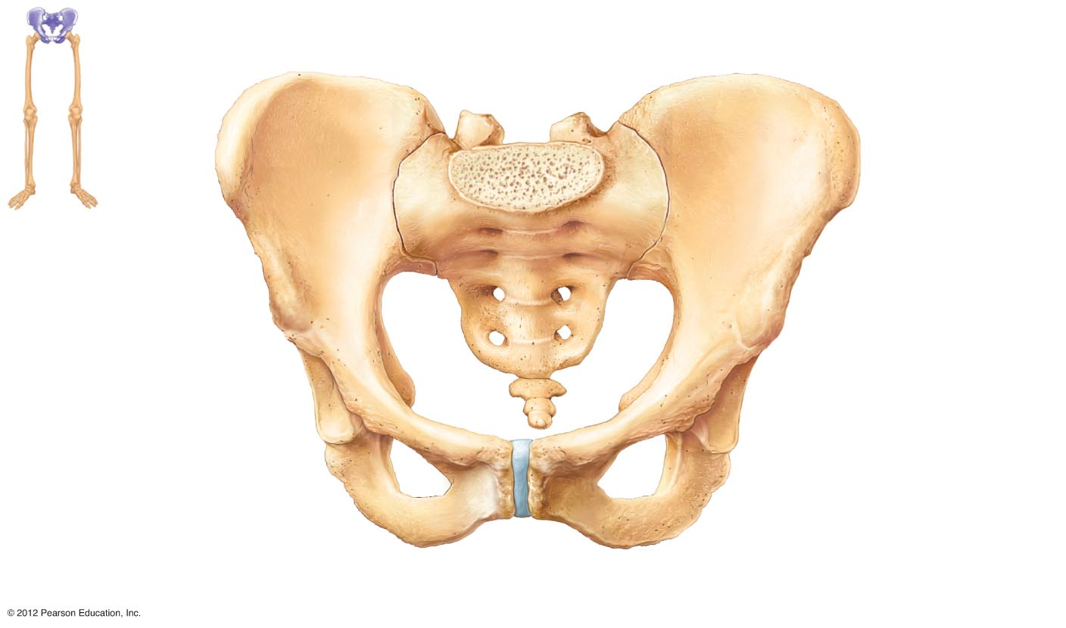
lliac crest
Sacroiliac joint
llium
Coxal bone (or hip bone)
Sacrum
Pelvic brim
Pubis
Coccyx
Ischial spine
Acetabulum
Ischium
Pubic symphysis
Pubic arch
(a)
Figure 5.26a

Slide 4
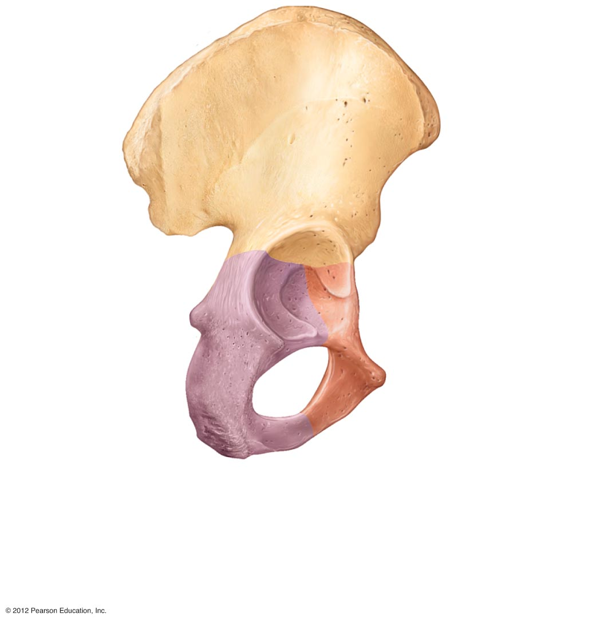
IIium
Ala
Posterior superior iliac spine
IIiac crest
Anterior superior iliac spine
Posterior inferior iliac spine
Anterior inferior iliac spine
Greater sciatic notch
Acetabulum
Ischial body
Body of pubis
Ischial spine
Pubis
Ischial tuberosity
Inferior pubic ramus
Ischium
Obturator foramen
Ischial ramus
(b)
Figure 5.26b

Slide 5
Gender Differences of the Pelvis
The female inlet is larger and more circular
The female pelvis as a whole is shallower, and the bones are lighter and thinner
The female ilia flare more laterally
The female sacrum is shorter and less curved
The female ischial spines are shorter and farther apart; thus the outlet is larger
The female pubic arch is more rounded because the angle of the pubic arch is greater

Slide 6
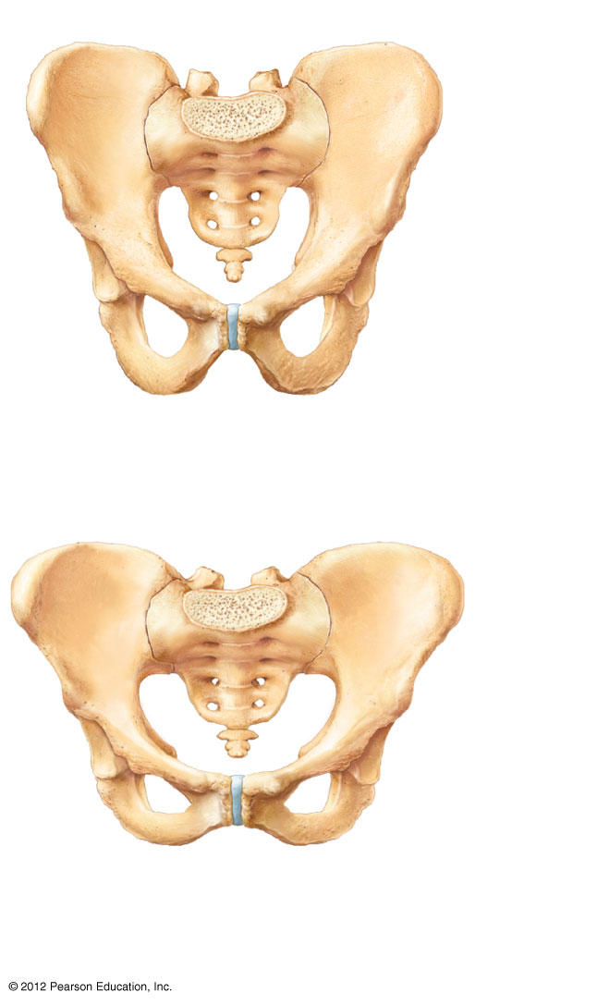
False pelvis
Inlet of true pelvis
Pelvic brim
Pubic arch (less than 90°)
False pelvis
Inlet of true pelvis
Pelvic brim
Pubic arch (more than 90°)
(c)
Figure 5.26c

Slide 7
Bones of the Lower Limbs
Femur—thigh bone
  The heaviest, strongest bone in the body
  Proximal end articulation
    Head articulates with the acetabulum of the coxal (hip) bone
  Distal end articulation
    Lateral and medial condyles articulate with the tibia in the lower leg

Slide 8
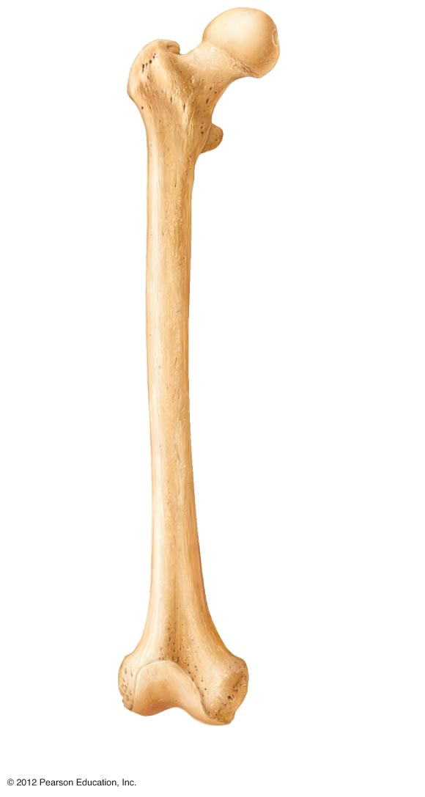
Neck
Head
Inter- trochanteric line
Lesser trochanter
Lateral condyle
Patellar surface
(a)
Figure 5.27a

Slide 9
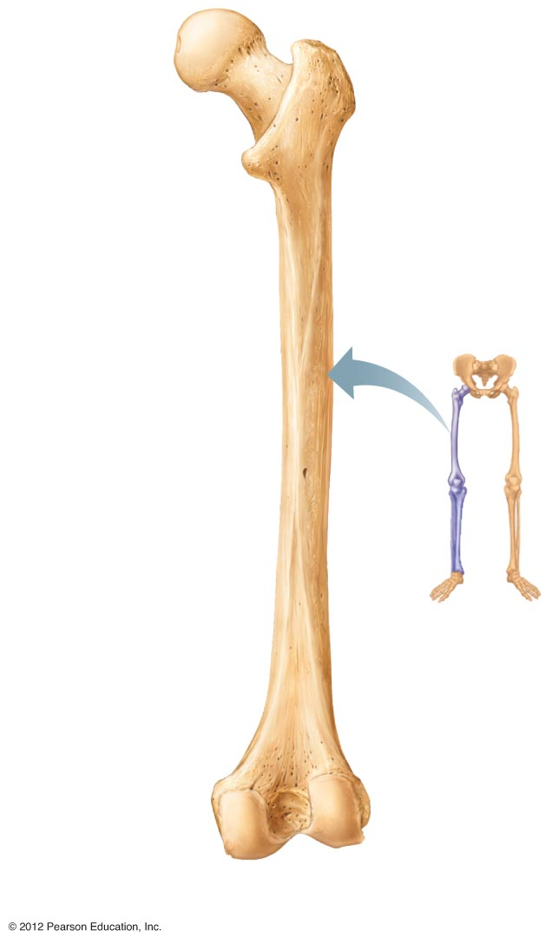
Greater trochanter
Head
Inter- trochanteric crest
Lesser trochanter
Gluteal tuberosity
Intercondylar fossa
Medial condyle
Lateral condyle
(b)
Figure 5.27b

Slide 10
Bones of the Lower Limbs
The lower leg has two bones
  Tibia—Shinbone; larger and medially oriented
    Proximal end articulation
      Medial and lateral condyles articulate with the femur to form the knee joint
  Fibula—Thin and sticklike; lateral to the tibia
    Has no role in forming the knee joint

Slide 11
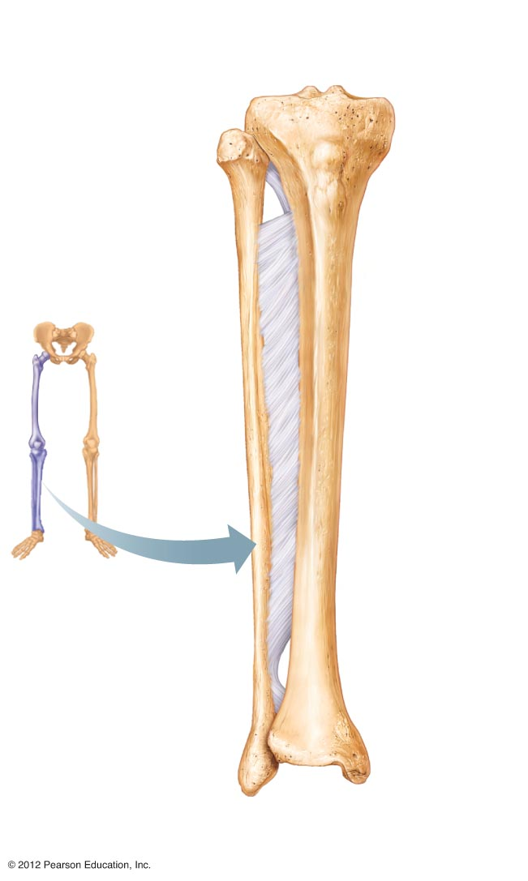
Intercondylar eminence
Lateral condyle
Medial condyle
Head
Tibial tuberosity
Proximal tibiofibular joint
Interosseous membrane
Anterior border
Fibula
Tibia
Distal tibiofibular joint
Lateral malleolus
Medial malleolus
(c)
Figure 5.27c

Slide 12
Bones of the Lower Limbs
The foot
  Tarsals—seven bones
    Two largest tarsals
      Calcaneus (heel bone)
      Talus
  Metatarsals—five bones form the sole of
  the foot
  Phalanges—fourteen bones form the toes

Slide 13
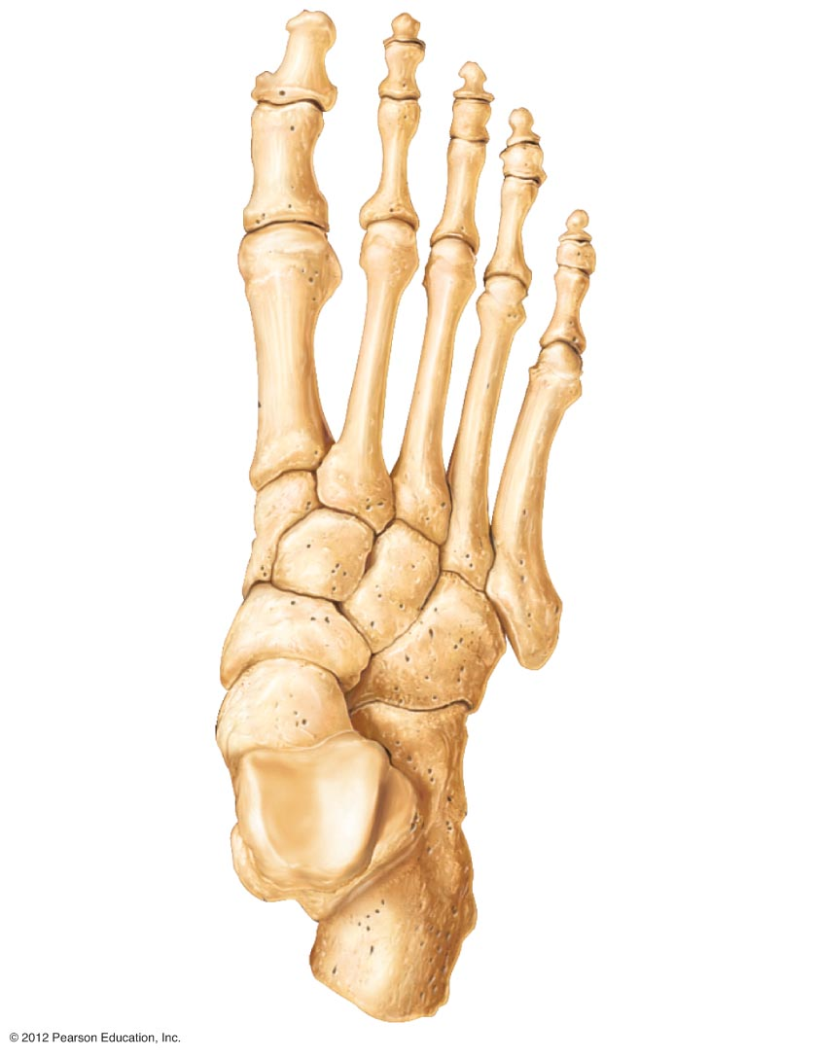
Phalanges:
Distal
Middle
Proximal
Tarsals:
Medial cuneiform
Metatarsals
Intermediatecuneiform
Tarsals:
Lateral cuneiform
Navicular
Cuboid
Talus
Calcaneus
Figure 5.28

Slide 14
Arches of the Foot
Bones of the foot are arranged to form three strong arches
  Two longitudinal
  One transverse

Slide 15
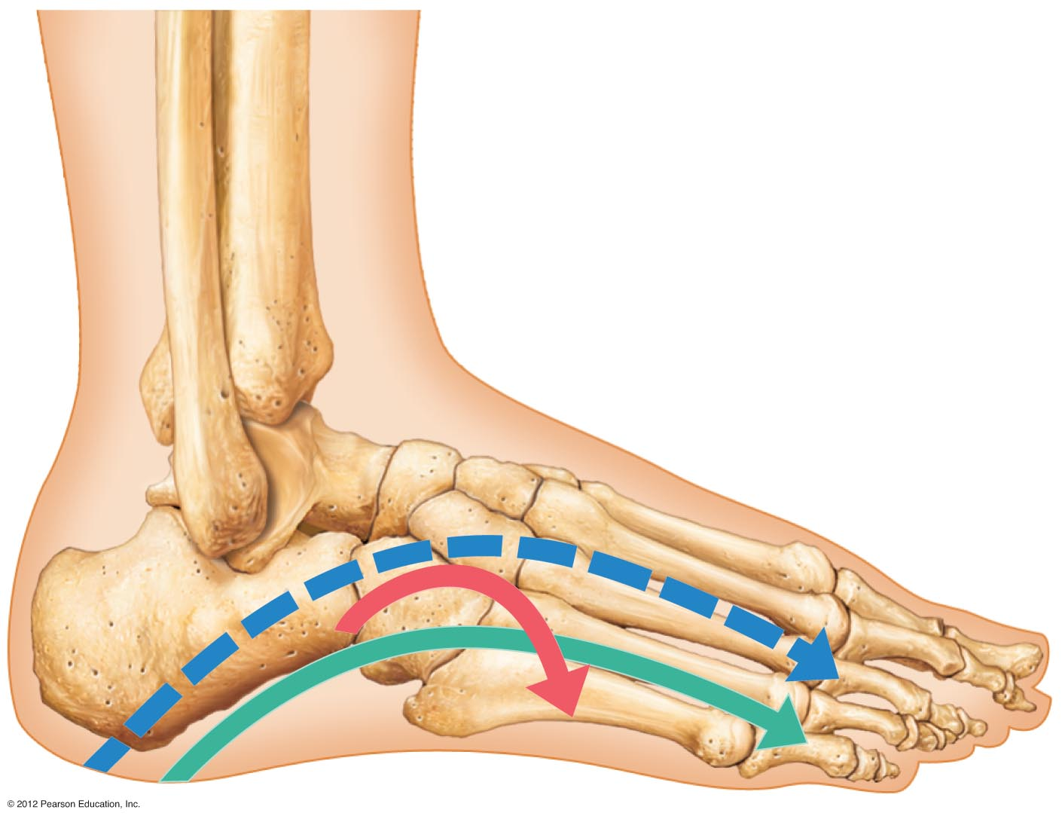
Medial longitudinal arch
Transverse arch
Lateral longitudinal arch
Figure 5.29

Slide 16
Joints
Articulations of bones
Functions of joints
  Hold bones together
  Allow for mobility
Two ways joints are classified
  Functionally
  Structurally

Slide 17
Functional Classification of Joints
Synarthroses
  Immovable joints
Amphiarthroses
  Slightly moveable joints
Diarthroses
  Freely moveable joints

Slide 18
Structural Classification of Joints
Fibrous joints
  Generally immovable
Cartilaginous joints
  Immovable or slightly moveable
Synovial joints
  Freely moveable

Slide 19
Fibrous Joints
Bones united by collagenic fibers
Types
  Sutures
    Immobile
  Syndesmoses
    Allows more movement than sutures but still immobile
    Example: Distal end of tibia and fibula
  Gomphosis
    Immobile

Slide 20
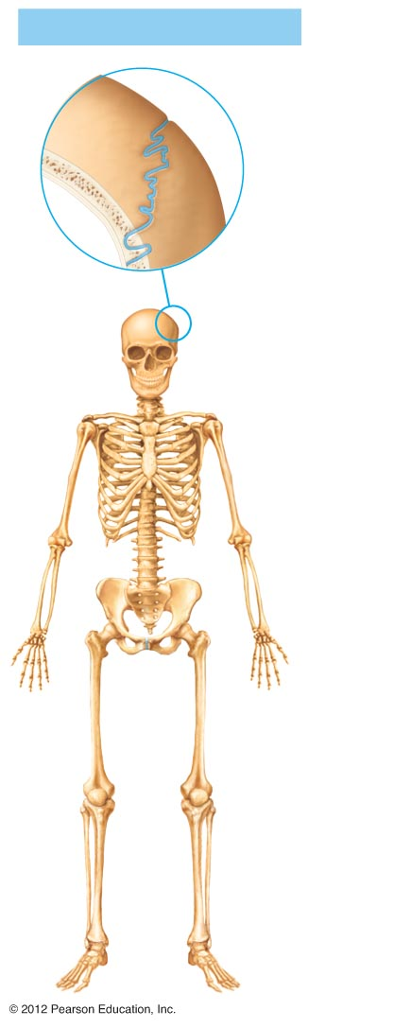
Fibrous joints
Fibrous connective tissue
(a) Suture
Figure 5.30a

Slide 21
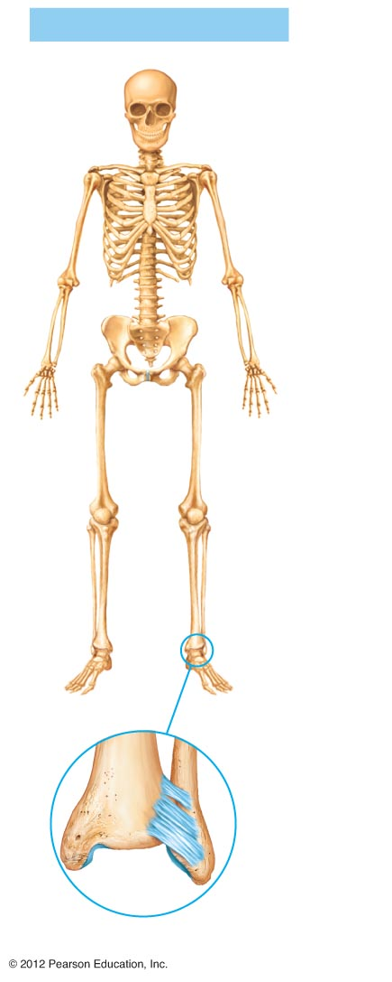
Fibrous joints
Tibia
Fibula
Fibrous
connective
tissue
(b) Syndesmosis
Figure 5.30b

Slide 22
Cartilaginous Joints
Bones connected by cartilage
Types
  Synchrondrosis
    Immobile
  Symphysis
    Slightly movable
    Example: Pubic symphysis, intervertebral joints

Slide 23
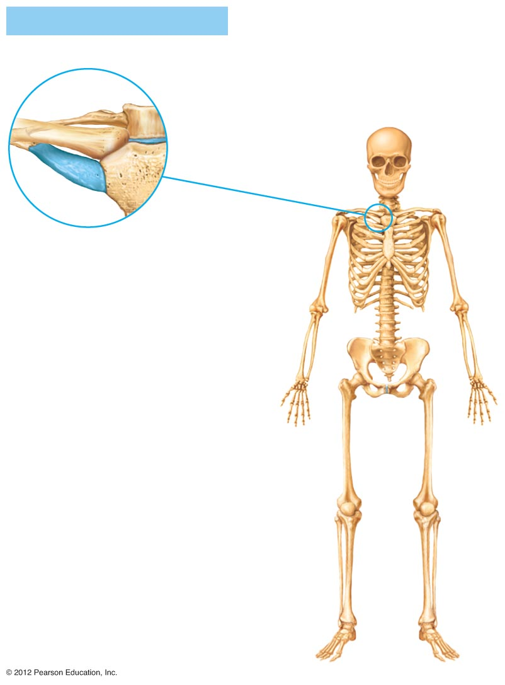
Cartilaginous joints
First rib
Hyaline cartilage
Sternum
(c) Synchondrosis
Figure 5.30c

Slide 24
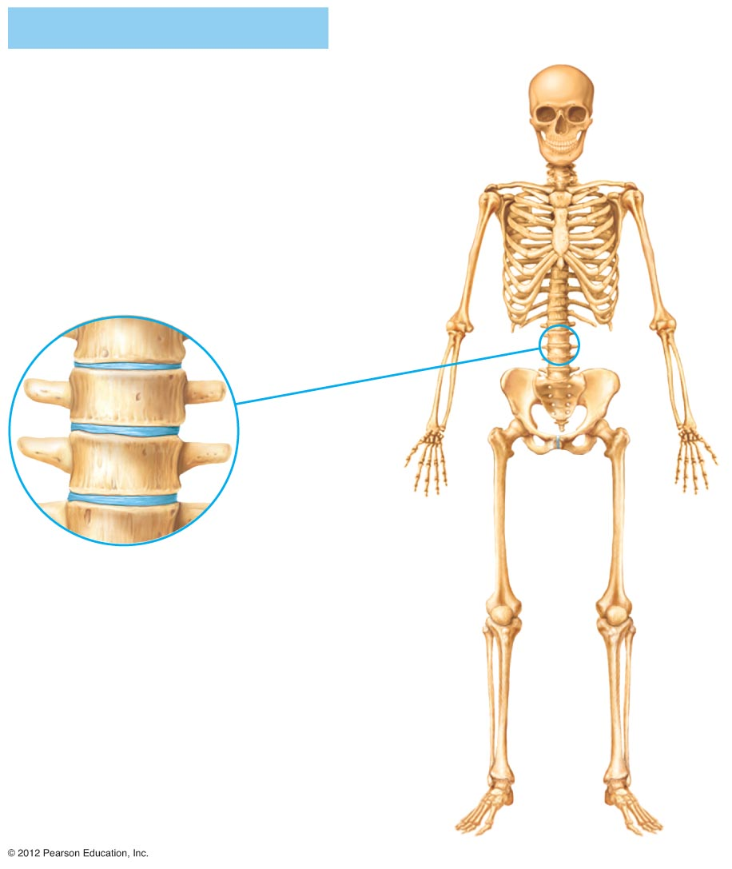
Cartilaginous joints
Vertebrae
Fibrocartilage
(d) Symphysis
Figure 5.30d

Slide 25
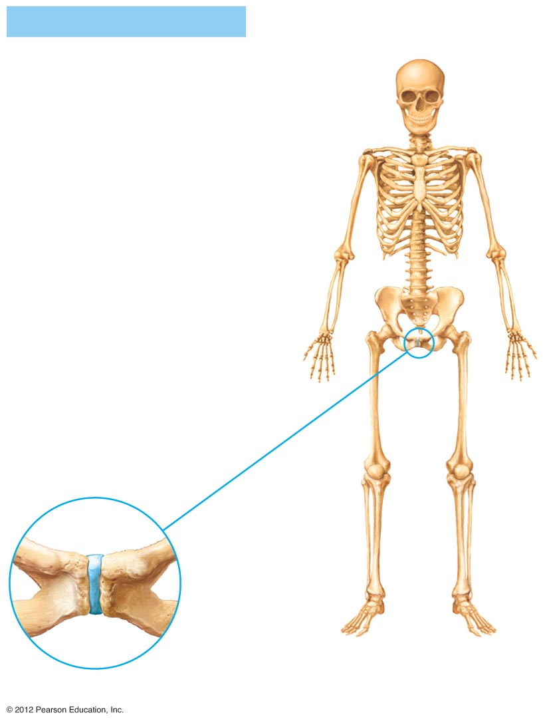
Cartilaginous joints
Pubis
Fibro- cartilage
(e) Symphysis
Figure 5.30e

Slide 26
Synovial Joints
Articulating bones are separated by a joint cavity
Synovial fluid is found in the joint cavity

Slide 27
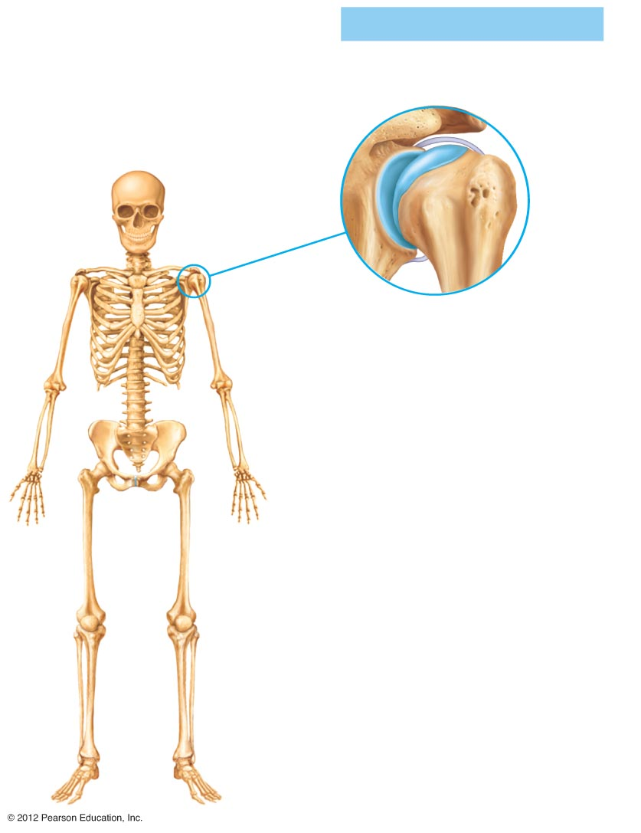
Synovial joints
Scapula
Articular capsule
Articular (hyaline) cartilage
Humerus
(f) Multiaxial joint
(shoulder joint)
Figure 5.30f

Slide 28
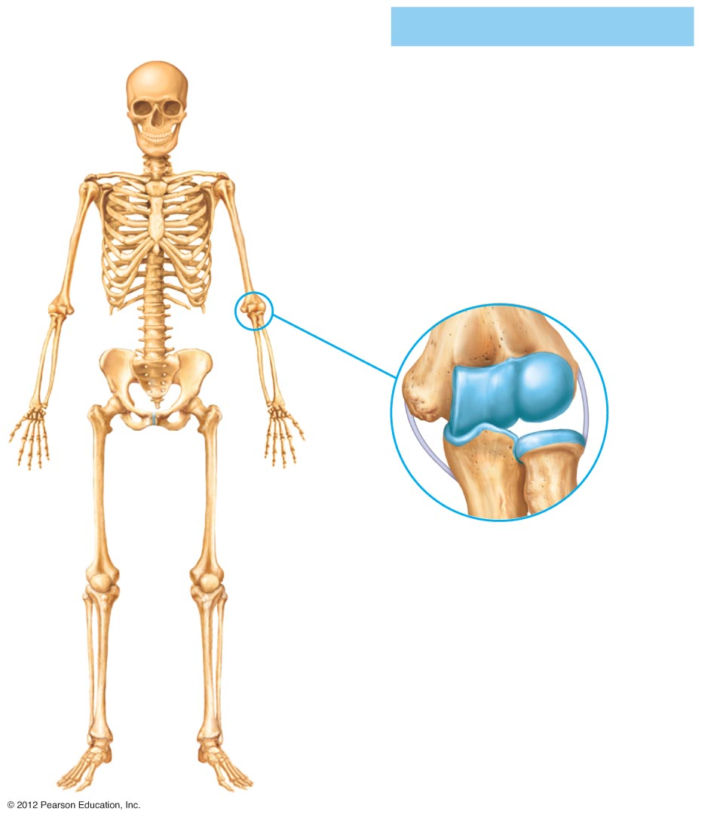
Synovial joints
Humerus
Articular (hyaline) cartilage
Articular capsule
Radius
(g) Uniaxial joint
(elbow joint)
Ulna
Figure 5.30g

Slide 29
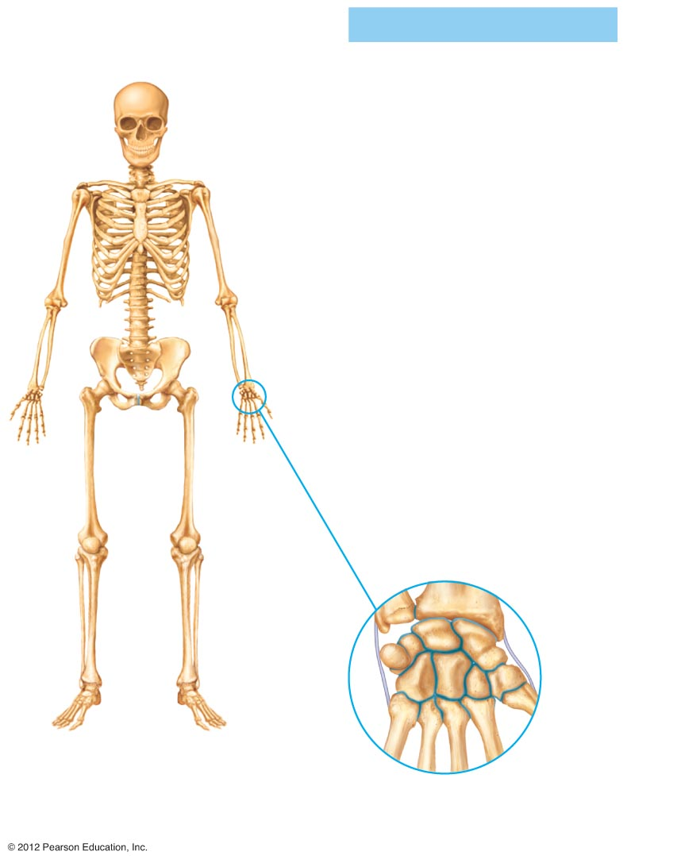
Synovial joints
Ulna
Radius
Articular capsule
Carpals
(h) Biaxial joint
(intercarpal joints of hand)
Figure 5.30h

Slide 30
Features of Synovial Joints
Articular cartilage (hyaline cartilage) covers the ends of bones
Articular capsule encloses joint surfaces and lined with synovial membrane
Joint cavity is filled with synovial fluid
Reinforcing ligaments

Slide 31
Structures Associated with the Synovial Joint
Bursae—flattened fibrous sacs
  Lined with synovial membranes
  Filled with synovial fluid
  Not actually part of the joint
Tendon sheath
  Elongated bursa that wraps around a tendon

Slide 32
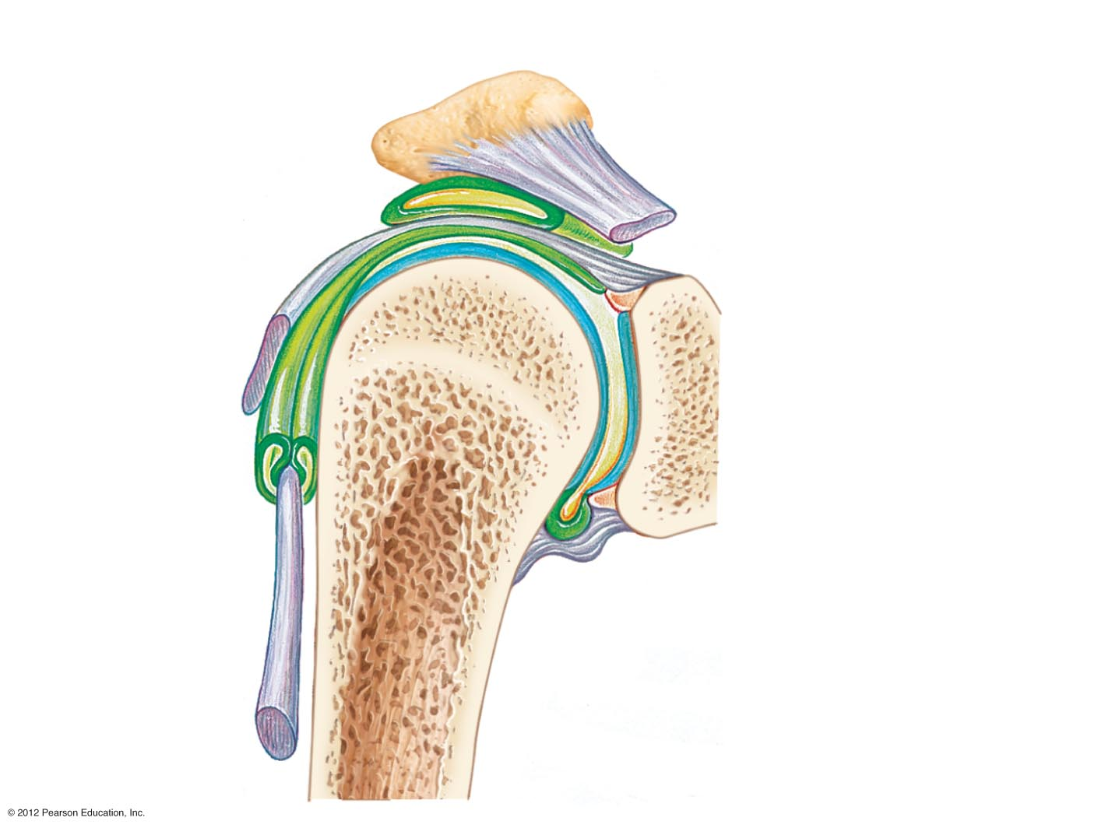
Acromion of scapula
Ligament
Joint cavity containing synovial fluid
Bursa
Ligament
Articular (hyaline) cartilage
Tendon sheath
Synovial membrane
Tendon of biceps muscle
Fibrous layer of the articular capsule
Humerus
Figure 5.31

Slide 33
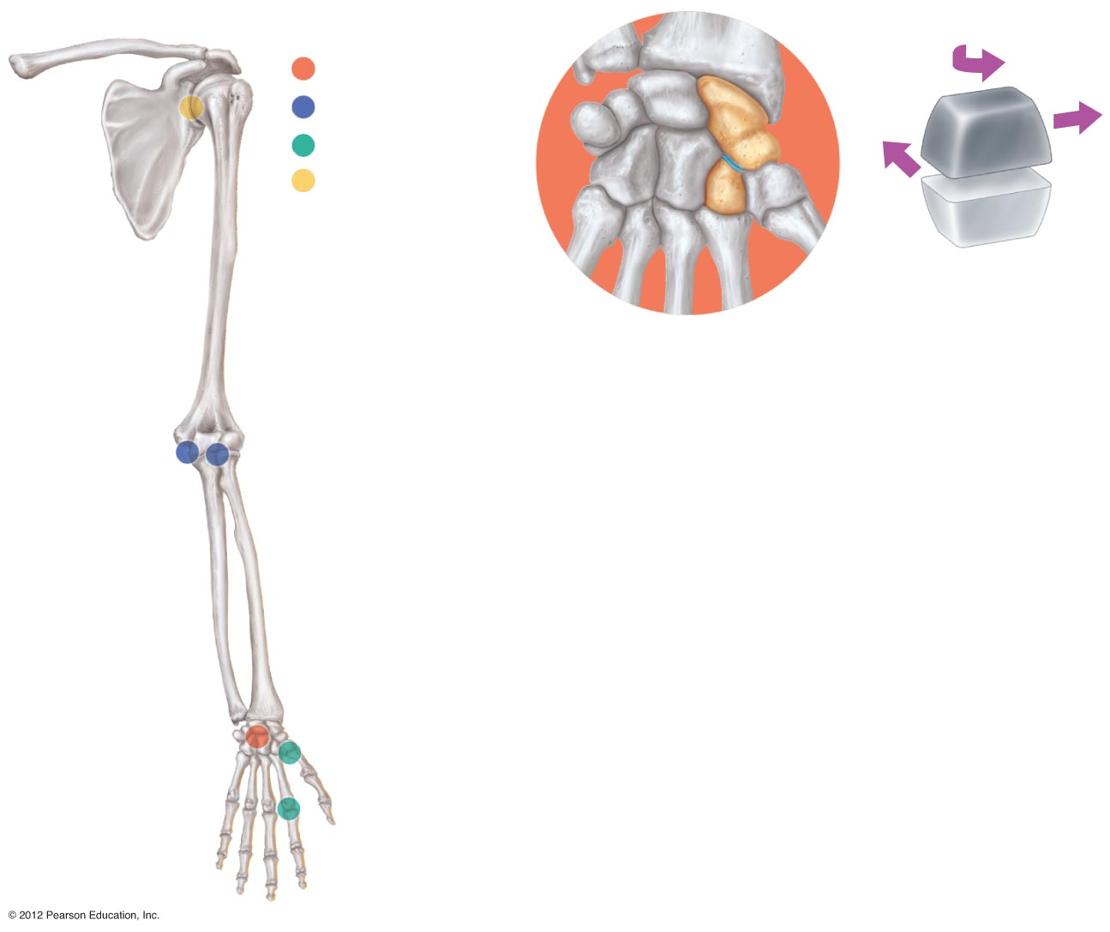
Nonaxial
Uniaxial
Biaxial
Multiaxial
(a) Plane joint
(a)
Figure 5.32a

Slide 34
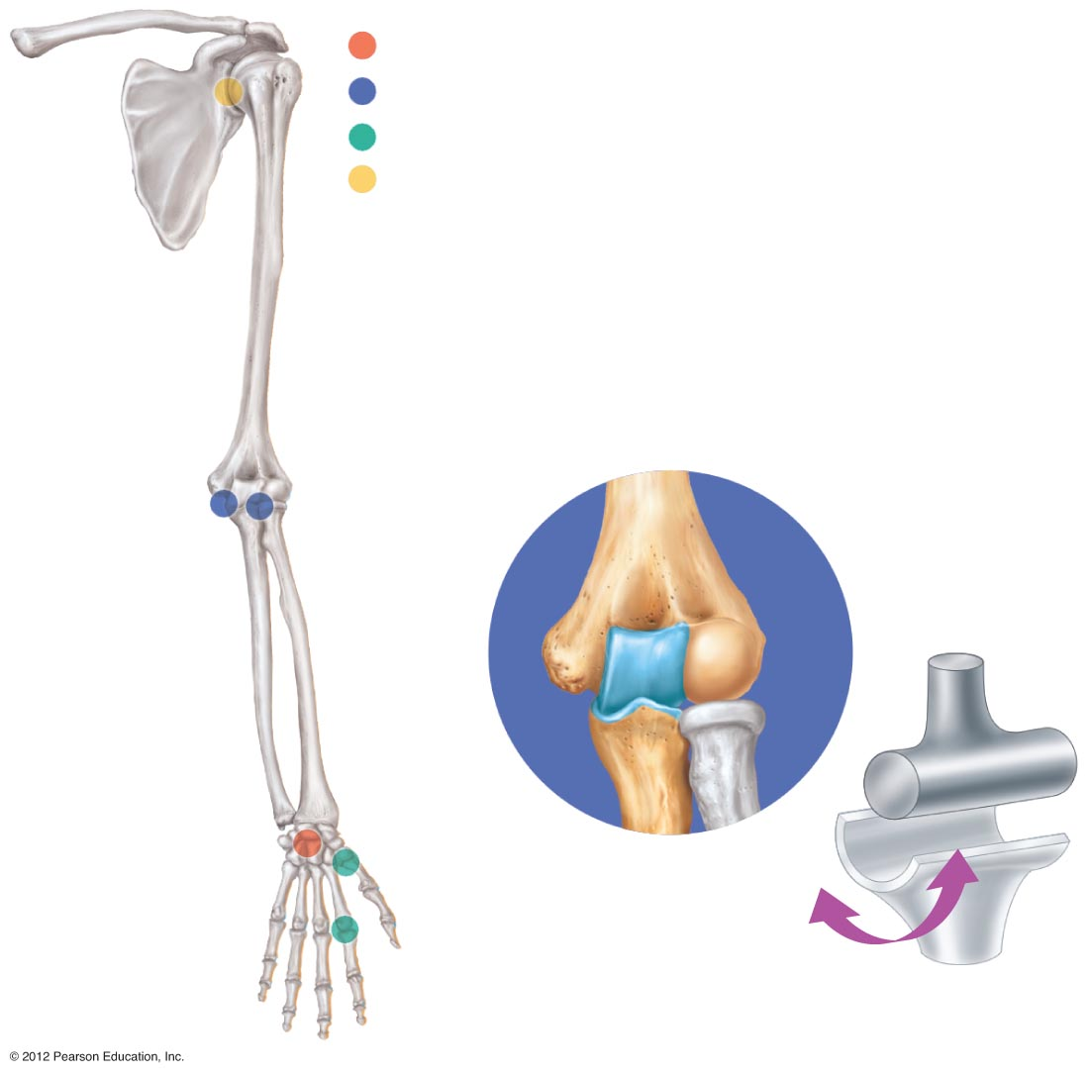
Nonaxial
Uniaxial
Biaxial
Multiaxial
(b)
Humerus
Ulna
(b) Hinge joint
Figure 5.32b

Slide 35
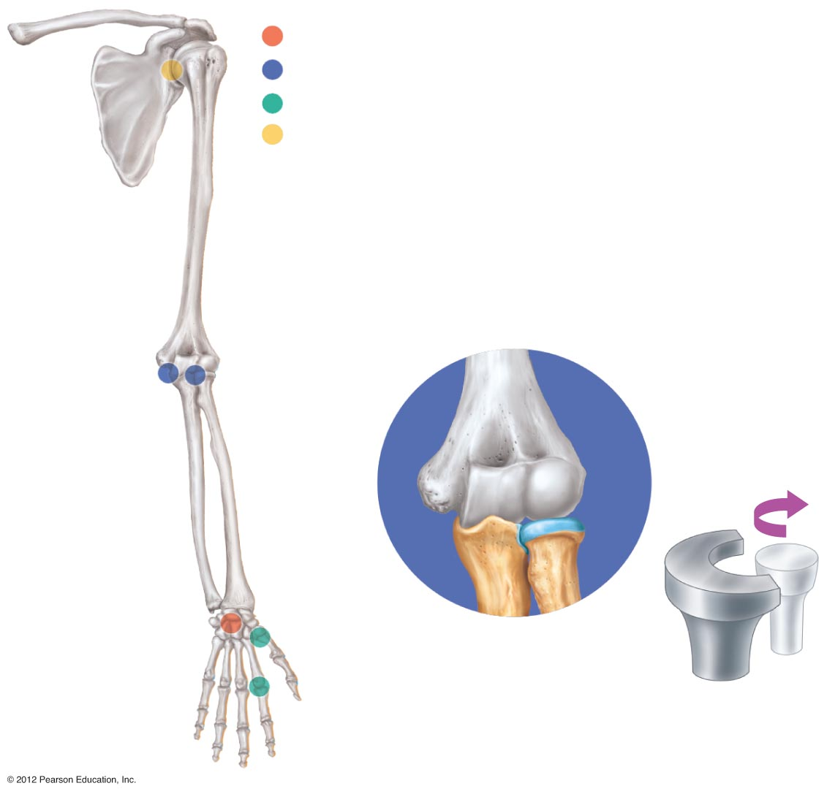
Nonaxial
Uniaxial
Biaxial
Multiaxial
Ulna
(c)
Radius
(c) Pivot joint
Figure 5.32c

Slide 36
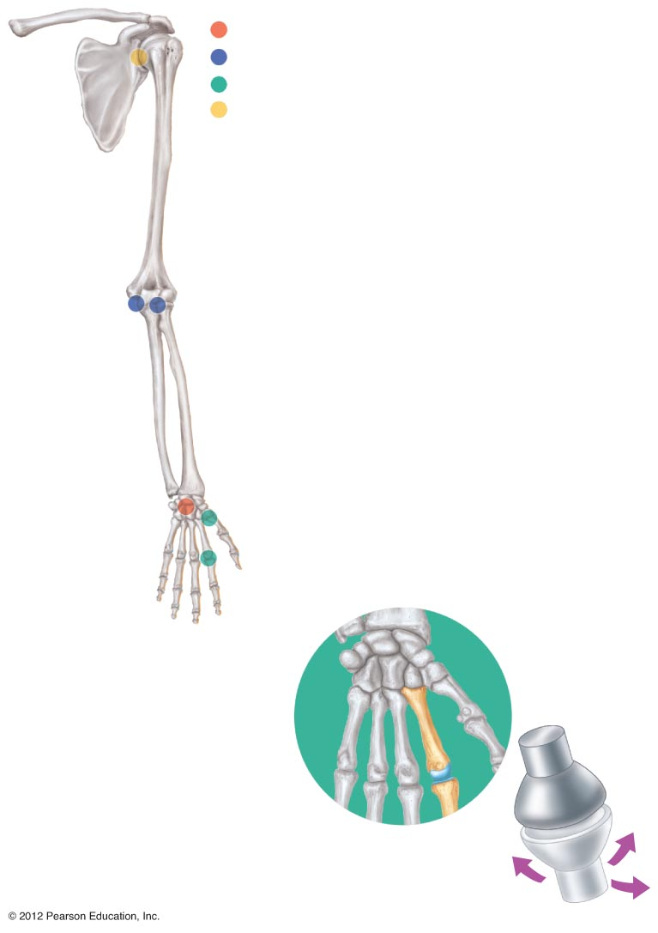
Nonaxial
Uniaxial
Biaxial
Multiaxial
(d)
Metacarpal
Phalanx
(d) Condylar joint
Figure 5.32d

Slide 37
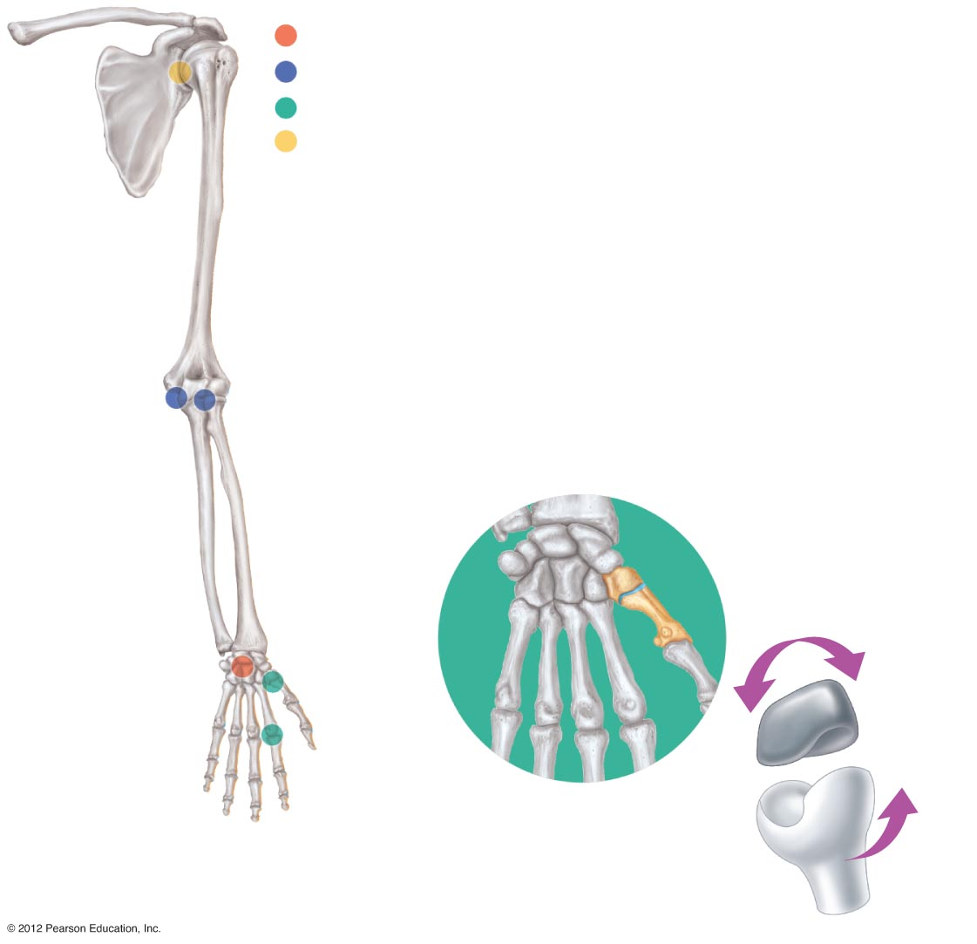
Nonaxial
Uniaxial
Biaxial
Multiaxial
Carpal
Metacarpal #1
(e)
(e) Saddle joint
Figure 5.32e

Slide 38
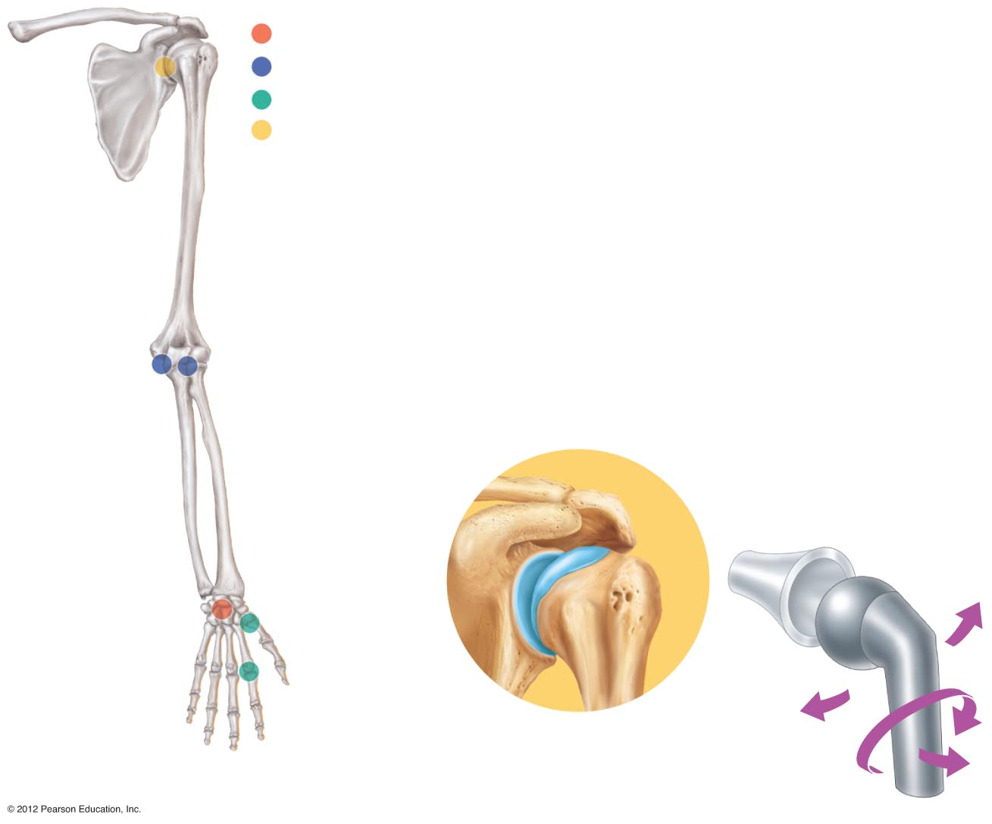
Nonaxial
Uniaxial
Biaxial
Multiaxial
(f)
Head of humerus
Scapula
(f) Ball-and-socket joint
Figure 5.32f

Slide 39
Inflammatory Conditions Associated with Joints
Bursitis—inflammation of a bursa usually caused by a blow or friction
Tendonitis—inflammation of tendon sheaths
Arthritis—inflammatory or degenerative diseases of joints
  Over 100 different types
  The most widespread crippling disease in the United States
  Initial symptoms: pain, stiffness, swelling of the joint

Slide 40
Clinical Forms of Arthritis
Osteoarthritis
  Most common chronic arthritis
  Probably related to normal aging processes
Rheumatoid arthritis
  An autoimmune disease—the immune system attacks the joints
  Symptoms begin with bilateral inflammation of certain joints
  Often leads to deformities

Slide 41
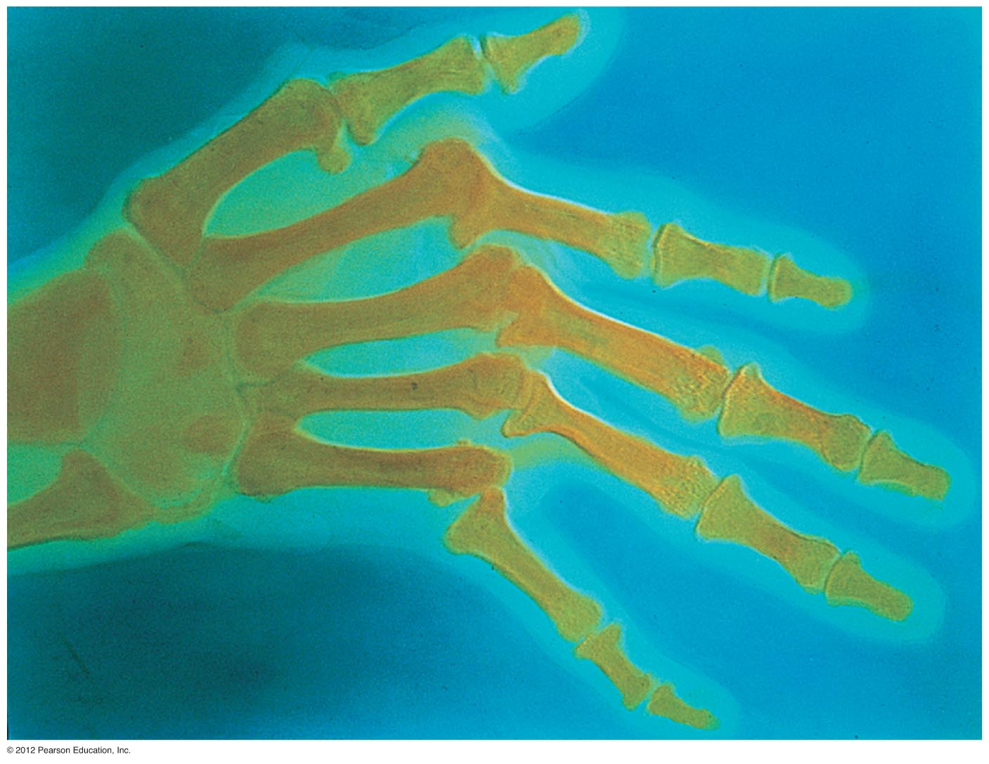
Figure 5.33

Slide 42
Clinical Forms of Arthritis
Gouty arthritis
  Inflammation of joints is caused by a deposition of uric acid crystals from the blood
  Can usually be controlled with diet
  More common in men

Slide 43
Developmental Aspects of the Skeletal System
At birth, the skull bones are incomplete
Bones are joined by fibrous membranes called fontanels
Fontanels are completely replaced with bone within two years after birth

Slide 44
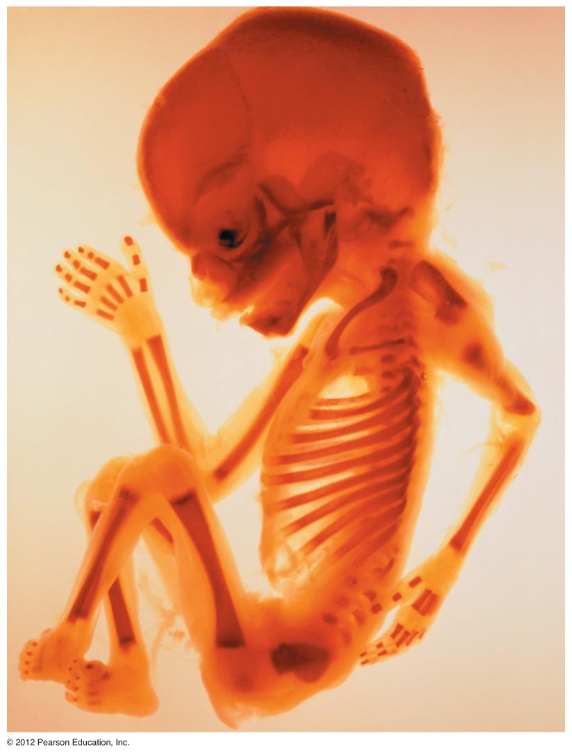
Parietal bone
Frontal bone
of skull
Occipital bone
Mandible
Clavicle
Scapula
Radius
Ulna
Humerus
Femur
Tibia
Ribs
Vertebra
Hip bone
Figure 5.34

Slide 45
Skeletal Changes Throughout Life
Fetus
  Long bones are formed of hyaline cartilage
  Flat bones begin as fibrous membranes
  Flat and long bone models are converted to bone
Birth
  Fontanels remain until around age 2

Slide 46
Skeletal Changes Throughout Life
Adolescence
  Epiphyseal plates become ossified and long bone growth ends
Size of cranium in relationship to body
  2 years old—skull is larger in proportion to the body compared to that of an adult
  8 or 9 years old—skull is near adult size and proportion
  Between ages 6 and 11, the face grows out from the skull

Slide 47
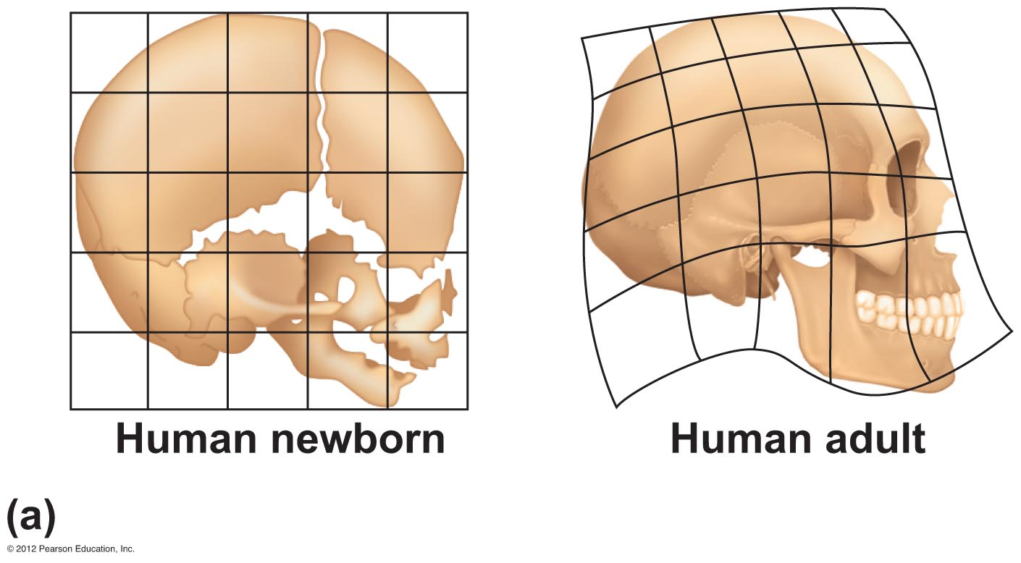
Figure 5.35a

Slide 48
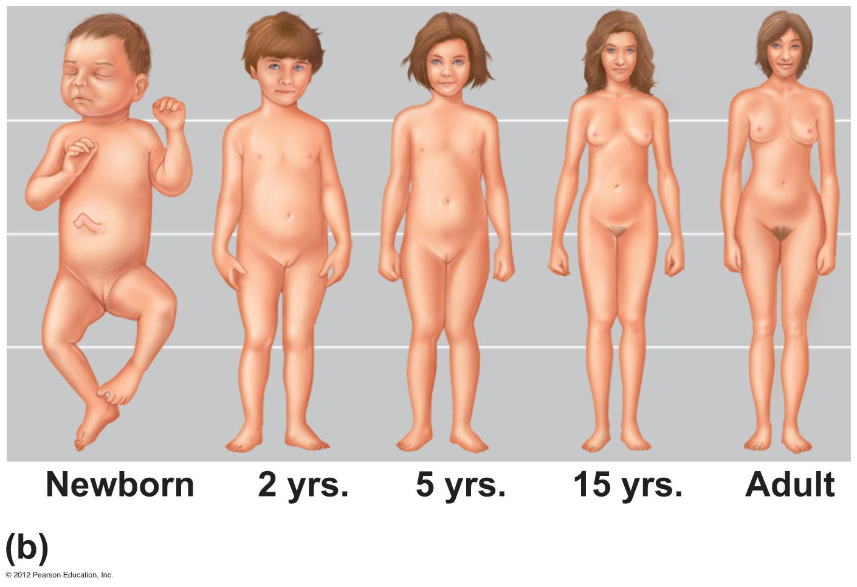
Figure 5.35b

Slide 49
Skeletal Changes Throughout Life
Curvatures of the spine
  Primary curvatures are present at birth and are convex posteriorly
  Secondary curvatures are associated with a child’s later development and are convex anteriorly
  Abnormal spinal curvatures (scoliosis and lordosis) are often congenital

Slide 50
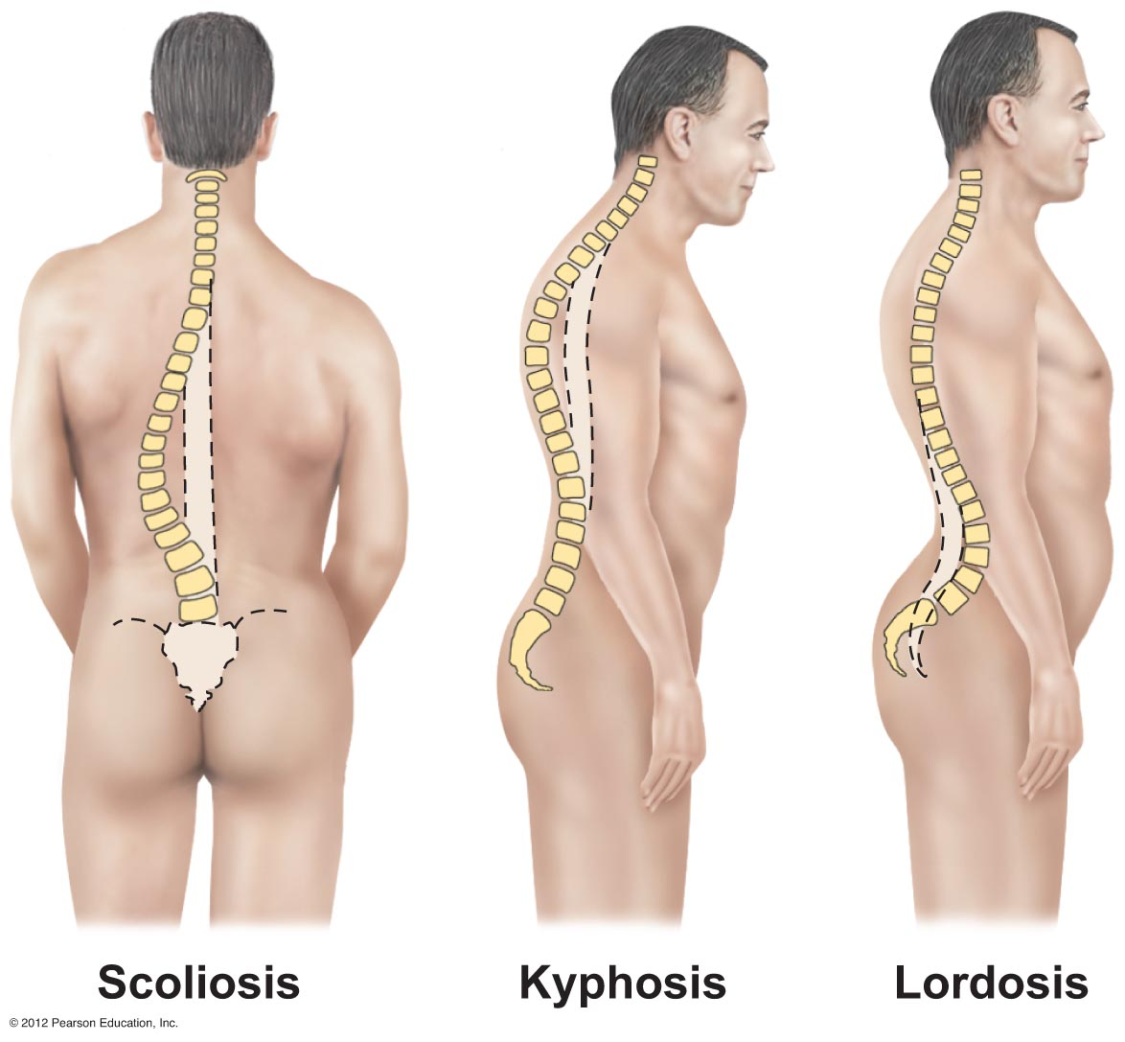
Figure 5.18

Slide 51
Skeletal Changes Throughout Life
Osteoporosis
  Bone-thinning disease afflicting
    50 percent of women over age 65
    20 percent of men over age 70
  Disease makes bones fragile and bones can easily fracture
  Vertebral collapse results in kyphosis (also known as dowager’s hump)
  Estrogen aids in health and normal density of a female skeleton

Slide 52
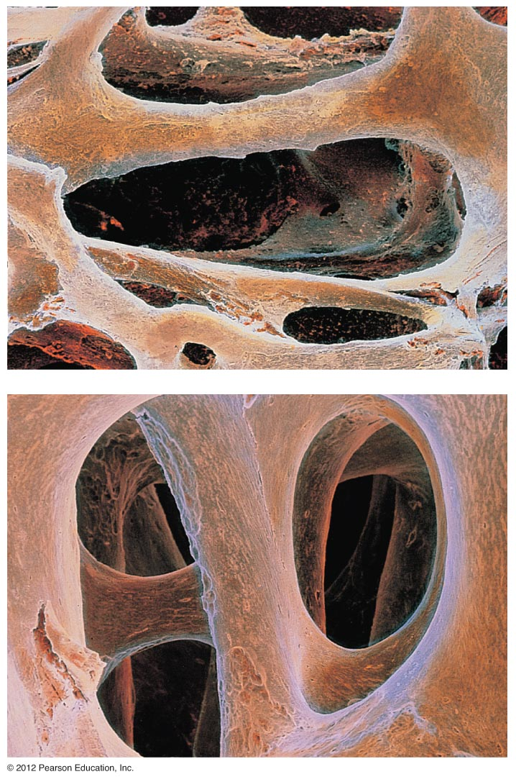
Figure 5.36

Slide 53
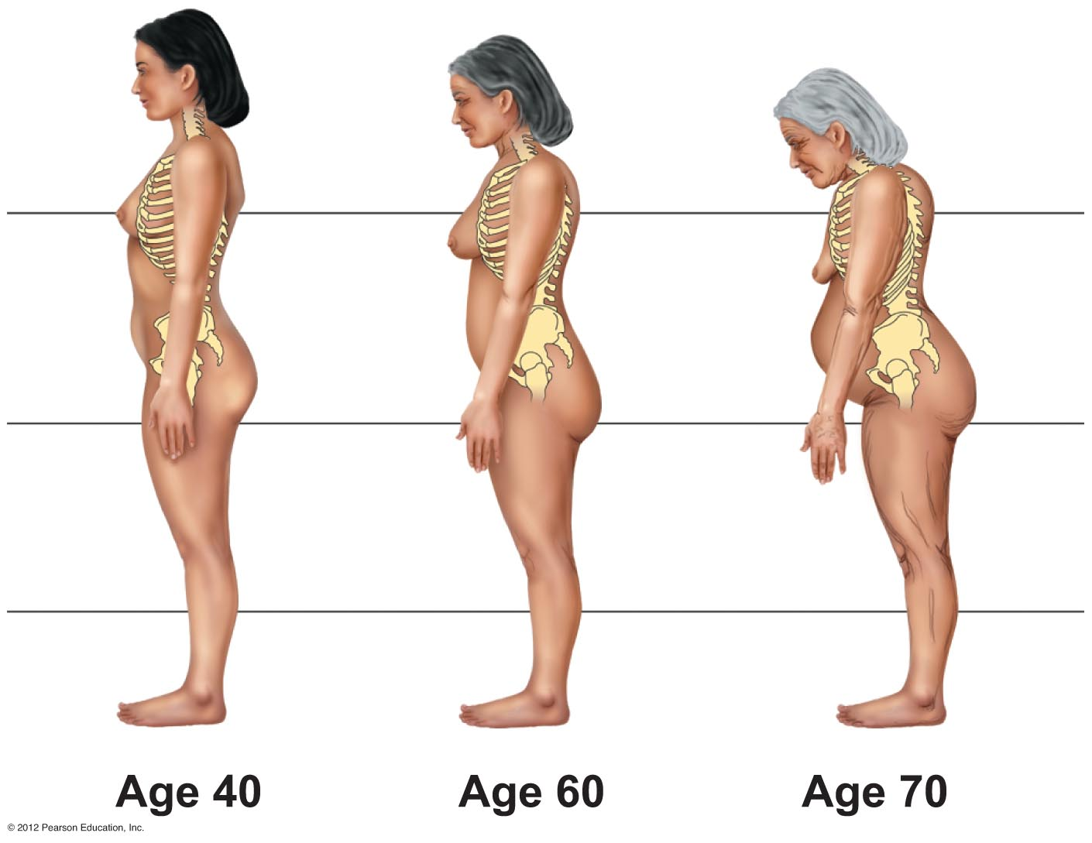
Figure 5.37

